Slide 1
Logical Credal Networks
Radu Marinescu
AWS: Haifeng Qian
IBM: Junkyu Lee, Debarun Bhattacharjya, Francisco Barahona, Tian Gao, Ryan Riegel, Alexander Gray
USP: Fabio Cozman

Slide 2
Knowledge Representation and Reasoning
Many (if not all) real-world applications require:
Efficient handling of uncertainty
Compact representation of a wide variety of knowledge
Probabilistic Logic – combines probability and logic in a principled manner. However, knowledge is typically imprecise or multiple sources of knowledge need to be combined
E.g., [finance] for more accurate credit card fraud detection, a statistical predictive model (uncertain historical data) can be combined with probabilistic logic rules (imprecise expert knowledge)
E.g., [chemistry] predict if the structure of molecule is valid or not, combine ML predictive model (“fingerprinted” historical data) with probabilistic logic encoding imprecise domain expert knowledge

Slide 3
Knowledge Representation and Reasoning
Logical Credal Networks (LCN)
Expressive probabilistic logic
propositional and FOL representations
Probability bounds (i.e., lower and upper bounds) on logic formulas
Very few restrictions on formulas
Ability to combine multiple sources of imprecise knowledge in a single framework
Efficient reasoning (inference) algorithms
Extensions include (future work):
Deep NNs based representations of probabilities (neural predicates)
Neural approximations of inference algorithms
Learning tractable classes of LCNs
[Marinescu et al, NeurIPS 2022; Marinescu et al, IJCAI 2023; Marinescu et al, NeurIPS 2024]

Slide 4
Outline
Motivation and Contribution
Background: Probabilistic Logic
Logical Credal Networks
Inference
Experimental Results
Conclusion and Next Steps

Slide 5
Probabilistic Logic
A set of logic formulas $q$ annotated with a probability value $α∈[0,1]$ representing the probability $P\left(q\right)$ of $q$ being true
Possible worlds semantics, namely $P\left(q\right)=α$ represents the set of probability distributions over all interpretations such that $P\left(q\right)=α$
i.e., $P(q)$ is the sum of the probabilities of the interpretations in which $q$ is true

Slide 6
Probabilistic Logic
A set of logic formulas $q$ annotated with a probability value $α∈[0,1]$ representing the probability $P\left(q\right)$ of $q$ being true
Possible worlds semantics, namely $P\left(q\right)=α$ represents the set of probability distributions over all interpretations such that $P\left(q\right)=α$
i.e., $P(q)$ is the sum of the probabilities of the interpretations in which $q$ is true
interpretations / worlds
…
$$P$$
$$x$$ | $$y$$ | $$z$$
0 | 0 | 0
0 | 0 | 1
0 | 1 | 0
0 | 1 | 1
1 | 0 | 0
1 | 0 | 1
1 | 1 | 0
1 | 1 | 1
$P\left(q\right):$ sum of the probabilities of the interpretations in which $q$ is true
i.e., $P\left(q\right)=p_{3}+p_{5}=0.7$
$$0.01$$
$$0.02$$
$$0.05$$
$$p_{1}$$
$$0.06$$
$$0.03$$
$$0.06$$
$$p_{2}$$
Formula $q$ is $(x⊕y)∧¬z$
$$0.6$$
$$0.4$$
$$0.2$$
$$p_{3}$$
$$P\left(q\right)=\left\{\begin{aligned}0.2+0.5 \\ 0.3+0.4 \\ 0.6+0.1 \\ …\end{aligned}\right.=0.7$$
$$P\left(q\right)=0.7$$
$$0.03$$
$$0.07$$
$$0.08$$
$$p_{4}$$
$$0.1$$
$$0.3$$
$$0.5$$
$$p_{5}$$
probability distributions
$$0.07$$
$$0.03$$
$$0.02$$
$$p_{6}$$
Distributions $P$ that satisfy $P\left(q\right)=α$
…
$$0.04$$
$$0.07$$
$$0.04$$
$$p_{7}$$
$$0.09$$
$$0.08$$
$$0.05$$
$$p_{8}$$
$\sum_{i=1}^{8}{p_{i}}=1$, and $p_{i}≥0, ∀i∈\{1, …,8\}$

Slide 7
Probabilistic Logic, Inference and Independence
Inference: given a probabilistic logic program (i.e., list of statements $α≤P\left(q\right)≤β$), and a query formula $ρ$, compute the posterior probability $P(ρ)$
Find the distributions $P(⋅)$ over the interpretations such that the logic program constraints are satisfied and $P(ρ)$ is minimized and, respectively, maximized!
Result is a probability interval $P\left(q\right)∈[\underline{P}\left(q\right),\overline{P}\left(q\right)]$
interpretations
Linear program
$$x$$ | $$y$$
0 | 0
0 | 1
1 | 0
1 | 1
$$0.3≤P\left(x\right)≤0.7$$
$$0.3≤P\left(x\right)≤0.7$$
$$0.3≤p_{3}+p_{4}≤0.7$$
$$p_{1}$$
$$0.3≤p_{2}+p_{4}≤0.7$$
$$0.3≤P\left(y\right)≤0.7$$
$$0.3≤P\left(y\right)≤0.7$$
$$p_{2}$$
$$p_{1}+p_{2}+p_{3}+p_{4}=1$$
Compute $P(x⊕y)$ ?
probabilities
$$p_{3}$$
$$p_{i}≥0, ∀i∈\{1,2,3,4\}$$
$$p_{4}$$
$$\min{/max{(p_{2}+p_{3})}}$$
$$Result:P\left(x⊕y\right)∈[0, 1]$$

Slide 8
Probabilistic Logic, Inference and Independence
Inference: given a probabilistic logic program (i.e., list of statements $α≤P\left(q\right)≤β$), and a query formula $ρ$, compute the posterior probability $P(ρ)$
Find the distributions $P(⋅)$ over the interpretations such that the logic program constraints are satisfied and $P(ρ)$ is minimized and, respectively, maximized
No assumptions about $x$ and $y$ so far. What if $x$ and $y$ are independent?
$$P\left(x,y\right)=P\left(x\right)⋅P(y)$$
interpretations
Non-linear program
$$x$$ | $$y$$
0 | 0
0 | 1
1 | 0
1 | 1
$$0.3≤P\left(x\right)≤0.7$$
$$0.3≤P\left(x\right)≤0.7$$
$$0.3≤p_{3}+p_{4}≤0.7$$
$$p_{1}$$
$$0.3≤p_{2}+p_{4}≤0.7$$
non-linear constraint
$$0.3≤P\left(y\right)≤0.7$$
$$0.3≤P\left(y\right)≤0.7$$
$$p_{2}$$
$$p_{1}+p_{2}+p_{3}+p_{4}=1$$
Compute $P(x⊕y)$ ?
probabilities
$$p_{3}$$
$$p_{i}≥0, ∀i∈\{1,2,3,4\}$$
$$p_{4}$$
$$p_{4}=\left(p_{3}+p_{4}\right)⋅(p_{2}+p_{4})$$
$$\min{/max{(p_{2}+p_{3})}}$$
$$Result:P\left(x⊕y\right)∈[0.42, 0.58]$$

Slide 9
Why Independencies?
Independence assumptions correspond to additional (non-linear) constraints over the $p_{i}$’s
Therefore, the space of probability distributions over the interpretations is further restricted!
This in turn may result in tighter posterior lower and upper bounds
interpretations
interpretations
…
$$P$$
$$x$$ | $$y$$ | $$z$$
0 | 0 | 0
0 | 0 | 1
0 | 1 | 0
0 | 1 | 1
1 | 0 | 0
1 | 0 | 1
1 | 1 | 0
1 | 1 | 1
$$P$$
$$x$$ | $$y$$ | $$z$$
0 | 0 | 0
0 | 0 | 1
0 | 1 | 0
0 | 1 | 1
1 | 0 | 0
1 | 0 | 1
1 | 1 | 0
1 | 1 | 1
$$0.01$$
$$0.02$$
$$0.05$$
$$p_{1}$$
$$0.05$$
$$p_{1}$$
$$0.06$$
$$0.03$$
$$0.06$$
$$p_{2}$$
$$0.06$$
$$p_{2}$$
$$p_{3}$$
independencies
$$p_{3}$$
$$0.6$$
$$0.4$$
$$0.2$$
$$0.2$$
$$0.03$$
$$0.07$$
$$0.08$$
$$p_{4}$$
$$0.08$$
$$p_{4}$$
$$0.1$$
$$0.3$$
$$0.5$$
$$p_{5}$$
$$0.5$$
$$p_{5}$$
probability distributions
probability distributions
$$0.07$$
$$0.03$$
$$0.02$$
$$p_{6}$$
$$0.02$$
$$p_{6}$$
…
$$0.04$$
$$0.07$$
$$0.04$$
$$p_{7}$$
$$0.04$$
$$p_{7}$$
$$0.09$$
$$0.08$$
$$0.05$$
$$p_{8}$$
$$0.05$$
$$p_{8}$$
$\sum_{i=1}^{8}{p_{i}^{k}}=1$, and $p_{i}^{k}≥0, ∀i∈\{1, …,8\}$
$\sum_{i=1}^{8}{p_{i}^{k}}=1$, and $p_{i}^{k}≥0, ∀i∈\{1, …,8\}$

Slide 10
Graphical Models and Independencies
Conditional Independence – very important (crucial) in graphical models
A Bayesian Network represents a probability distribution in a very compact form by exploiting conditional independencies between variables
$$P\left(X_{1},…,X_{n}\right)=\prod_{i=1}^{n}{P(X_{i}|pa\left(X_{i}\right))}$$

Slide 11
Graphical Models and Independencies
Conditional Independence – very important (crucial) in graphical models
A Bayesian Network represents a probability distribution in a very compact form by exploiting conditional independencies between variables
Variable $X$ is conditionally independent of $Y$ given $Z$ if $P(X|Y, Z) = P(X|Z)$
Intuitively, $Y$ tells us nothing more about $X$ than we know by knowing $Z$
$$P\left(X_{1},…,X_{n}\right)=\prod_{i=1}^{n}{P(X_{i}|pa\left(X_{i}\right))}$$
chain
$$X$$
common descendants
common ancestors
$$X$$
$$Y$$
$$Z$$
$$Z$$
$$Y$$
$$Z$$
$$X$$
$$Y$$
$$P\left(Y | X,Z\right)=P(Y|Z)$$
$$P\left(X | Y\right)=P(X)$$
$$P\left(X | Y,Z\right)=P(X|Z)$$

Slide 12
Graphical Models and Independencies
A Bayesian Network models many conditional independencies relating variables and sets, which are defined in terms of the graphical criterion called d-separation
d-separation = conditional independence
Let $X$, $Y$ and $Z$ be three sets of variables
If sets $X$ and $Y$ are d-separated by set $Z$ then $X$ and $Y$ are conditionally independent given $Z$, namely $P(X|Y, Z) = P(X|Z)$
Intuition: $X$ is d-separated from $Y$ given $Z$, if every undirected path between $X$ and $Y$ is blocked by $Z$ – path blocking expands on the 3 basic independence structures
Local Markov Condition in Bayesian Networks:
Every variable $X$ is conditionally independent of its non-descendants given its parents

Slide 13
Bayesian Networks
MINVOLSET
PULMEMBOLUS
INTUBATION
KINKEDTUBE
VENTMACH
DISCONNECT
PAP
SHUNT
VENTLUNG
VENITUBE
PRESS
MINOVL
FIO2
VENTALV
ANAPHYLAXIS
PVSAT
ARTCO2
TPR
SAO2
INSUFFANESTH
EXPCO2
HYPOVOLEMIA
LVFAILURE
CATECHOL
LVEDVOLUME
STROEVOLUME
HISTORY
ERRBLOWOUTPUT
HR
ERRCAUTER
CVP
PCWP
CO
HREKG
HRSAT
HRBP
BP
The “alarm” network: 37 variables, 509 parameters (instead of 2³⁷)

Slide 14
Outline
Motivation and Contribution
Background: Probabilistic Logic
Logical Credal Networks
Inference
Experimental Results
Conclusion and Next Steps

Slide 15
Logical Credal Networks
[Marinescu et al, NeurIPS 2022]
A set of probability-labeled sentences of the following form:
where $q$ and $r$ can be arbitrary propositional or first-order logic* formulas, $l_{q}$ and $u_{q}$ (resp., $l_{q|r}$ and $u_{q|r}$) are lower and upper probability bounds
a label $τ∈\{yes, no\}$ indicates independence between the atoms in $q$ (details to follow)
Represents set of probability distributions over all interpretations satisfying LCN’s constraints
$$l_{q}≤P\left(q\right)≤u_{q}$$
$$l_{q|r}≤P\left(q | r\right)≤u_{q|r}$$
Friends of friends are likely friends. If two people are friends, they likely either both smoke or neither does. Smoking likely causes cancer.
*universally quantified FOL with finite domains of values

Slide 16
A Simple Example
LCN sentences:
Burglaries ($b$) and more common than earthquakes ($e$). The house alarm ($a$) is usually triggered during a burglary or an earthquake. In case of an alarm, either both Charles ($c$) and Dan ($d$) call 911 or they don’t. There’s a small chance that the alarm is triggered accidentally. Based on [Pearl88]
$$0.1≤P\left(b\right)≤0.2$$
$$0.05≤P\left(e\right)≤0.1$$
$$0.8≤P\left(a | b∨e\right)≤0.9$$
linear constraints on $p_{i}$’s
$$0.7≤P\left(¬(c⊕d) | a\right)≤0.8$$
$$0.01≤P\left(a\right)≤0.08$$
interpretations
Constraints on distribution:
$$P$$
$$a$$ | $$b$$ | $$c$$ | $$d$$ | $$e$$
0 | 0 | 0 | 0 | 0
0 | 0 | 0 | 0 | 1
0 | 0 | 0 | 1 | 0
0 | 0 | 0 | 1 | 1
0 | 0 | 1 | 0 | 0
0 | 0 | 1 | 0 | 1
0 | 0 | 1 | 1 | 0
…
1 | 1 | 1 | 1 | 1
$${0.12≤p}_{9}+…+p_{16}+p_{25}+…+p_{32}≤0.25$$
$$p_{1}$$
$$0.18≤p_{2}+p_{4}+p_{6}+…+p_{30}+p_{32}≤0.32$$
$$p_{2}$$
$$p_{3}$$
$$\left(p_{18}+p_{20}+p_{22}+…\right)−0.97⋅\left(p_{2}+p_{4}+…+p_{8}+…\right)≤0$$
$$p_{4}$$
$$\left(p_{18}+p_{20}+p_{22}+…\right)−0.94⋅\left(p_{2}+p_{4}+…+p_{8}+…\right)≥0$$
…
$$p_{5}$$
$$p_{6}$$
probability distribution
$$p_{1}+p_{2}+…+p_{32}=1$$
$$p_{i}≥0, ∀i∈\{1, …, 32\}$$
$$p_{7}$$
…
Probability distributions that satisfy the LCN’s constraints
i.e., figure out the $p_{i}$’s such that the constraints are satisfied
$$p_{32}$$

Slide 17
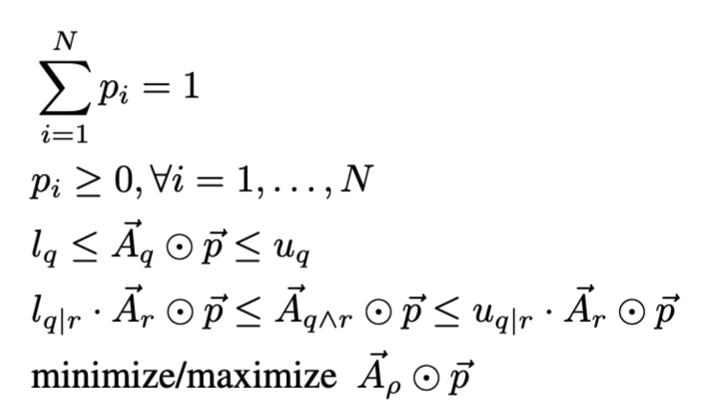
Inference: Answering Queries in LCNs
Given a query formula $ρ$, compute lower and upper bounds on $P(ρ)$
Solving the linear program from the previous example yields the desired bounds
However, these bounds may be too loose to be informative
$n$ atoms, $N=2^{n}$ interpretations (worlds)
$\vec{p}=(p_{1},…,p_{N})$probability vector
${\vec{A}}_{q}=(a_{1}, …,a_{N})$ indicator vector,
$a_{i}=1$ if $q$ is true in $i^{th}$ interpretation
$a_{i}=0$, otherwise
$⊙$ is the dot-product of two vectors
$$l_{q}≤P\left(q\right)≤u_{q}$$
$$l_{q|r}≤P\left(q | r\right)≤u_{q|r}$$

Slide 18
A Simple Example
indicator vectors
$${\vec{A}}_{b}$$
0
0
0
0
0
0
0
0
1
1
1
1
1
1
1
1
0
0
0
0
0
0
0
0
1
1
1
1
1
1
1
1
$${\vec{A}}_{e}$$
0
1
0
1
0
1
0
1
0
1
0
1
0
1
0
1
0
1
0
1
0
1
0
1
0
1
0
1
0
1
0
1
$${\vec{A}}_{a}$$
0
0
0
0
0
0
0
0
0
0
0
0
0
0
0
0
1
1
1
1
1
1
1
1
1
1
1
1
1
1
1
1
$${\vec{A}}_{b∨e}$$
0
1
0
1
0
1
0
1
1
1
1
1
1
1
1
1
0
1
0
1
0
1
0
1
1
1
1
1
1
1
1
1
$${\vec{A}}_{a∧(b∨e)}$$
0
0
0
0
0
0
0
0
0
0
0
0
0
0
0
0
0
1
0
1
0
1
0
1
1
1
1
1
1
1
1
1
$${\vec{A}}_{a∧¬(c⊕d)}$$
0
0
0
0
0
0
0
0
0
0
0
0
0
0
0
0
1
1
0
0
0
0
1
1
1
1
0
0
0
0
1
1
LCN:
Constraints on distribution:
$$0.1≤P\left(b\right)≤0.2$$
$$0.1≤{\vec{A}}_{b}⊙\vec{p}≤0.2$$
$$0.05≤P\left(e\right)≤0.1$$
$$0.05≤{\vec{A}}_{e}⊙\vec{p}≤0.1$$
$$0.8≤P\left(a | b∨e\right)≤0.9$$
$${\vec{A}}_{a∧(b∨e)}⊙\vec{p}−0.9 {\vec{A}}_{b∨e}≤0$$
$$0.7≤P\left(¬(c⊕d) | a\right)≤0.8$$
$${\vec{A}}_{a∧(b∨e)}⊙\vec{p}−0.8 {\vec{A}}_{b∨e}≥0$$
$$0.01≤P\left(a\right)≤0.08$$
$${\vec{A}}_{¬\left(c⊕d\right)∧a}⊙\vec{p}−0.8 {\vec{A}}_{a}≤0$$
Query: $P\left(b∧e\right)= ?$
$${\vec{A}}_{¬\left(c⊕d\right)∧a}⊙\vec{p}−0.7 {\vec{A}}_{a}≥0$$
$$0.01≤{\vec{A}}_{a}⊙\vec{p}≤0.08$$
$$p_{1}+p_{2}+…+p_{32}=1$$
$$p_{i}≥0, ∀i∈\{1, …, 32\}$$
Answer: $P\left(b∧e\right)∈[0, 1]$
Objective:
$$\min{/\max{{\vec{A}}_{b∧e}⊙}}\vec{p}$$

Slide 19
LCNs and Independence
We would like to be able to make additional independence assumptions
e.g., like in the first example where $x$ and $y$ were assumed independent
For example: assume $b$ and $e$ are independent
i.e., burglaries and earthquakes are independent of each other
$$0.12≤{\vec{A}}_{b}⊙\vec{p}≤0.25$$
LCN:
$$0.18≤{\vec{A}}_{e}⊙\vec{p}≤0.32$$
$$0.12≤P\left(b\right)≤0.25$$
$${\vec{A}}_{a∧(b∨e)}⊙\vec{p}−0.97 {\vec{A}}_{b∨e}≤0$$
$$0.18≤P\left(e\right)≤0.32$$
Assume: $b$ and $e$ are independent
$${\vec{A}}_{a∧(b∨e)}⊙\vec{p}−0.94 {\vec{A}}_{b∨e}≥0$$
$$0.94≤P\left(a | b∨e\right)≤0.97$$
$$P\left(b,e\right)=P\left(b\right)⋅P(e)$$
$${\vec{A}}_{¬\left(c⊕d\right)∧a}⊙\vec{p}−0.95 {\vec{A}}_{a}≤0$$
$$0.85≤P\left(¬(c⊕d) | a\right)≤0.95$$
$$0.02≤P\left(a\right)≤0.04$$
$${\vec{A}}_{¬\left(c⊕d\right)∧a}⊙\vec{p}−0.85 {\vec{A}}_{a}≥0$$
$$0.02≤{\vec{A}}_{a}⊙\vec{p}≤0.04$$
Query: $P(b∧e)$
Answer: $P\left(b∧e\right)∈[0.005, 0.008]$
$${\vec{A}}_{b∧e}⊙\vec{p}−{(\vec{A}}_{b}⊙\vec{p})⋅({\vec{A}}_{e}⊙\vec{p})=0$$
$$p_{1}+p_{2}+…+p_{32}=1$$
$$p_{i}≥0, ∀i∈\{1, …, 32\}$$
$$\min{/\max{{\vec{A}}_{b∧e}⊙}}\vec{p}$$

Slide 20
LCNs and Independence
We don’t want to assert independencies in an arbitrary manner
Instead, we will do it in a principled manner (like the way it’s done in graphical models)
Basic idea:
Build a graphical representation of LCNs (i.e., primal graph)
Define parents and descendants of LCN’s atoms
Assert independencies between atoms using a Local Markov Condition for LCNs

Slide 21
Stamps
Stamps are associated with LCN’s sentences
Definition: a stamp is a directed graph with formula nodes (white), atomic nodes (blue) and directed edges from $q$ to its atoms ($τ=yes$) or directed edges from $q$ to its atoms and from $q$’s atoms to $q$ ($τ=no$)
$$l_{q|r}≤P\left(q|r\right)≤u_{q|r}$$
$$τ=no$$
$$l_{q}≤P\left(q\right)≤u_{q}$$
$$τ=no$$
a
x
No independence assumptions between the atoms $x$, $y$ and $z$
y
b
r
q
y
x
q
z
c
z
(e.g., $q$ is $x∨¬y∨¬z$)
$$l_{q|r}≤P\left(q|r\right)≤u_{q|r}$$
$$τ=yes$$
$$l_{q}≤P\left(q\right)≤u_{q}$$
$$τ=yes$$
a
x
y
Assume some independence between the atoms $x$, $y$ and $z$
x
q
b
r
q
y
z
c
z

Slide 22
Primal Graph
Given an LCN $ℒ$, the primal graph is the union of the stamps associated with $ℒ$’s sentences
$$0.1≤P\left(b\right)≤0.2$$
$$b$$
$$e$$
$$0.05≤P\left(e\right)≤0.1$$
$$b∨e$$
$$a$$
$$0.8≤P\left(a | b∨e\right)≤0.9$$
$$τ=no$$
$$¬(c⊕d)$$
$$0.7≤P\left(¬(c⊕d) | a\right)≤0.8$$
$$0.01≤P\left(a\right)≤0.08$$
$$c$$
$$d$$
$$parents\left(a\right)=\{b,e\}$$
$$parents\left(c\right)=\{a, d\}$$
$$descendants\left(a\right)=\{c,d\}$$
$$descendants\left(c\right)=\{d\}$$

Slide 23
Local Markov Condition
Let $ℒ$ be an LCN, and $ℳ$ be a model* of $ℒ$. Given M, every atom $x$ is conditional independent of its non-descendant non-parent (ndnp) atoms given its parents in the primal graph $G$ of $ℒ$.
We are now ready to make quantitative commitments (i.e., explicit independence assumptions)
Let $x$ be an atom, $S_{x}=\{s_{1},…,s_{k}\}$ and $T_{x}=\{t_{1},…,t_{l}\}$ be its parents and ndnp’s sets in $G$
we assert $P\left(x | S_{x},T_{x}\right)=P(x|S_{x})$ or equivalently $P\left(x,S_{x},T_{x}\right)⋅P\left(S_{x}\right)=P\left(x,S_{x}\right)⋅P(S_{x},T_{x})$
$$0.1≤P\left(b\right)≤0.2$$
$$b$$
$$e$$
$b$ and $e$ are independent
$c$ is CI of $\{b,e\}$ given $\{a,d\}$
$d$ is CI of $\{b,e\}$ given $\{a,c\}$
$$0.05≤P\left(e\right)≤0.1$$
$$b∨e$$
$$a$$
$$0.8≤P\left(a | b∨e\right)≤0.9$$
$$τ=no$$
$$¬(c⊕d)$$
$$0.7≤P\left(¬(c⊕d) | a\right)≤0.8$$
$$P\left(b|e\right)=P\left(b\right)$$
$$0.01≤P\left(a\right)≤0.08$$
$$P\left(c|b,e,a,d\right)=P\left(c|a,d\right)$$
$$c$$
$$d$$
$$P\left(d|b,e,a,c\right)=P\left(d|a,c\right)$$

Slide 24
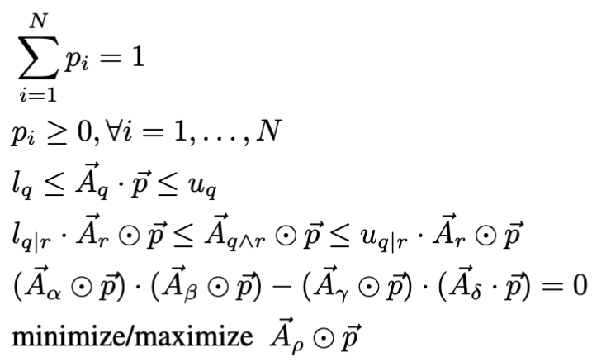
Exact Inference in LCNs
Given a query formula $ρ$, compute posterior lower and upper bounds on $P(ρ)$
Let $x$ be an atom, $S_{x}=\{s_{1},…,s_{k}\}$ and $T_{x}=\{t_{1},…,t_{l}\}$ be its parents and ndnp’s sets in $G$ we assert $P\left(x | S_{x},T_{x}\right)=P(x|S_{x})$ or equivalently $P\left(x,S_{x},T_{x}\right)⋅P\left(S_{x}\right)=P\left(x,S_{x}\right)⋅P(S_{x},T_{x})$
$n$ atoms, $N=2^{n}$ interpretations (worlds)
$\vec{p}=(p_{1},…,p_{N})$probability vector
${\vec{A}}_{q}=(a_{1}, …,a_{N})$ indicator vector,
$a_{i}=1$ if $q$ is true in $i^{th}$ interpretation
$a_{i}=0$, otherwise
$⊙$ is the dot-product of two vectors
$$l_{q}≤P\left(q\right)≤u_{q}$$
$$l_{q|r}≤P\left(q | r\right)≤u_{q|r}$$
$P\left(x,S_{x},T_{x}\right)⋅P\left(S_{x}\right)−P\left(x,S_{x}\right)⋅P\left(S_{x},T_{x}\right)=0$
$$α=x∧s_{1}∧…∧s_{k}∧t_{1}∧…∧t_{l}$$
$$γ=x∧s_{1}∧…∧s_{k}$$
$$β=s_{1}∧…∧s_{k}$$
$$δ=s_{1}∧…∧s_{k}∧t_{1}∧…∧t_{l}$$

Slide 25
Example
LCN:
$$b$$
$$e$$
Independence assumptions:
$$0.1≤P\left(b\right)≤0.2$$
$$P\left(b|e\right)=P\left(b\right)$$
$$0.05≤P\left(e\right)≤0.1$$
$$b∨e$$
$$a$$
$$P\left(c|a,b\right)=P\left(c|a\right)$$
$$0.8≤P\left(a | b∨e\right)≤0.9$$
$$P\left(c|a,e\right)=P\left(c|a\right)$$
$$τ=yes$$
$$¬(c⊕d)$$
$$P\left(d|a,b\right)=P\left(d|a\right)$$
$$0.7≤P\left(¬(c⊕d) | a\right)≤0.8$$
$$P\left(d|a,e\right)=P\left(d|a\right)$$
$$0.01≤P\left(a\right)≤0.08$$
Query: $P(a∧¬b)$
$$c$$
$$d$$
$$0.1≤{\vec{A}}_{b}⊙\vec{p}≤0.2$$
$${\vec{A}}_{b∧e}⊙\vec{p}−{(\vec{A}}_{b}⊙\vec{p})⋅({\vec{A}}_{e}⊙\vec{p})=0$$
$$0.05≤{\vec{A}}_{e}⊙\vec{p}≤0.1$$
$${(\vec{A}}_{c∧a∧b}⊙\vec{p})⋅({\vec{A}}_{a}⊙\vec{p})−{(\vec{A}}_{a∧b}⊙\vec{p})⋅({\vec{A}}_{c}⊙\vec{p})=0$$
$${\vec{A}}_{a∧(b∨e)}⊙\vec{p}−0.9 {\vec{A}}_{b∨e}≤0$$
$${(\vec{A}}_{c∧a∧e}⊙\vec{p})⋅({\vec{A}}_{a}⊙\vec{p})−{(\vec{A}}_{a∧e}⊙\vec{p})⋅({\vec{A}}_{c}⊙\vec{p})=0$$
$${\vec{A}}_{a∧(b∨e)}⊙\vec{p}−0.8 {\vec{A}}_{b∨e}≥0$$
$${(\vec{A}}_{d∧a∧b}⊙\vec{p})⋅({\vec{A}}_{a}⊙\vec{p})−{(\vec{A}}_{a∧b}⊙\vec{p})⋅({\vec{A}}_{d}⊙\vec{p})=0$$
$${\vec{A}}_{¬\left(c⊕d\right)∧a}⊙\vec{p}−0.8 {\vec{A}}_{a}≤0$$
$${\vec{A}}_{¬\left(c⊕d\right)∧a}⊙\vec{p}−0.7 {\vec{A}}_{a}≥0$$
$${(\vec{A}}_{d∧a∧e}⊙\vec{p})⋅({\vec{A}}_{a}⊙\vec{p})−{(\vec{A}}_{a∧e}⊙\vec{p})⋅({\vec{A}}_{d}⊙\vec{p})=0$$
$$0.01≤{\vec{A}}_{a}⊙\vec{p}≤0.08$$
$$p_{1}+p_{2}+…+p_{32}=1$$
$$\min{/\max{{\vec{A}}_{a∧¬b}⊙}}\vec{p}$$
$$p_{i}≥0, ∀i∈\{1, …, 32\}$$

Slide 26
Approximate Inference in LCNs
[Marinescu et al, IJCAI 2023]
Exact inference is intractable and therefore limited to small LCNs (up to 10 propositions)
ARIEL: message-passing scheme on a factor graph representation of LCNs
Example LCN:
Factor graph
$$0.2≤P\left(a\right)≤0.3$$
$$f_{1}$$
$$0.2≤P\left(a\right)≤0.3$$
$$0.6≤P\left(b|a\right)≤0.7$$
$$a$$
$$f_{2}$$
$$0.6≤P\left(b|a\right)≤0.7$$
$$0.1≤P\left(b|¬a\right)≤0.2$$
$$0.1≤P\left(b|¬a\right)≤0.2$$
$$b$$
$$0.3≤P\left(b\right)≤0.4$$
$$f_{3}$$
$$0.3≤P\left(b\right)≤0.4$$
Bi-partite graph with variable nodes (circles) and
factor nodes (squares). A variable node corresponds
to an atom, while a factor node represents one or more
sentences that involve the same set of atoms. A factor
node is connected a variable node if they share the same atom.

Slide 27
ARIEL: AppRoximate InfErence in LCNs
Iterative propagation of variable-to-factor and factor-to-variable messages until convergence
variable-to-factor: $[l_{v→f},u_{v→f}]$
$$f_{1}$$
$$0.2≤P\left(a\right)≤0.3$$
$$l_{v→f}=\max_{f^{′}∈N\left(v\right)∖\{f\}}{l_{f^{′}→v}}$$
$$a$$
$$u_{v→f}=\min_{f^{′}∈N\left(v\right)∖\{f\}}{u_{f^{′}→v}}$$
$$f_{2}$$
$$0.6≤P\left(b|a\right)≤0.7$$
$$0.1≤P\left(b|¬a\right)≤0.2$$
factor-to-variable: $[l_{f→v},u_{f→v}]$
$$b$$
$$\sum_{i=1}^{K}{p_{i}=1}$$
$$f_{3}$$
$$0.3≤P\left(b\right)≤0.4$$
$$p_{i}≥0, ∀i=1,…,K$$
Properties:
Reduced complexity
Exact on singly-connected LCNs
Scales to large LCNs
$$l_{q}≤A_{q}⊙\overline{p}≤u_{q}$$
$$l_{q|r}A_{r}⊙\overline{p}≤A_{q∧r}⊙\overline{p}≤u_{q|r}A_{r}⊙\overline{p}$$
$$A_{v^{′}∧v^{′′}}⊙\overline{p}=\left(A_{v^{′}}⊙\overline{p}\right)\left(A_{v^{′′}}⊙\overline{p}\right), ∀v^{′}≠v^{′′}∈N(f)$$
minimize/maximize $A_{v}⊙\overline{p}$

Slide 28
Properties
Theorem: ARIEL is exact on singly-connected LCNs.
Proof: follows easily now (and more elegantly) from the factorization result on chain graphs (a singly-connected LCN has a chain graph structure) – see [Cozman et al, IJAR 2024].
Complexity: Exponential in the scope of the factor.
(as opposed to exponential in the number of variables)

Slide 29
MAP and Marginal MAP Inference
[Marinescu et al, NeurIPS 2024]
Up until now, focus was on computing a probability interval $P\left(q\right)∈[\underline{P}\left(q\right),\overline{P}\left(q\right)]$ for a given query formula $q$
MAP/MMAP inference calls for finding the most probable (complete or partial) explanation of observed evidence in an LCN
$$S$$
$$0.05≤P\left(B\right)≤0.1$$
$$0.3≤P\left(S\right)≤0.4$$
$$B∨C$$
$$0.1≤P\left(B∨C | S\right)≤0.2$$
$$B$$
$$C$$
$$¬(X⊕D)$$
$$0.6≤P\left(D | B∧C\right)≤0.7$$
$$0.7≤P\left(¬(X⊕D) | C\right)≤0.8$$
$$D$$
$$X$$
$$B∧C$$
Evidence: $¬B, C$
MAP: S, D, X

Slide 30
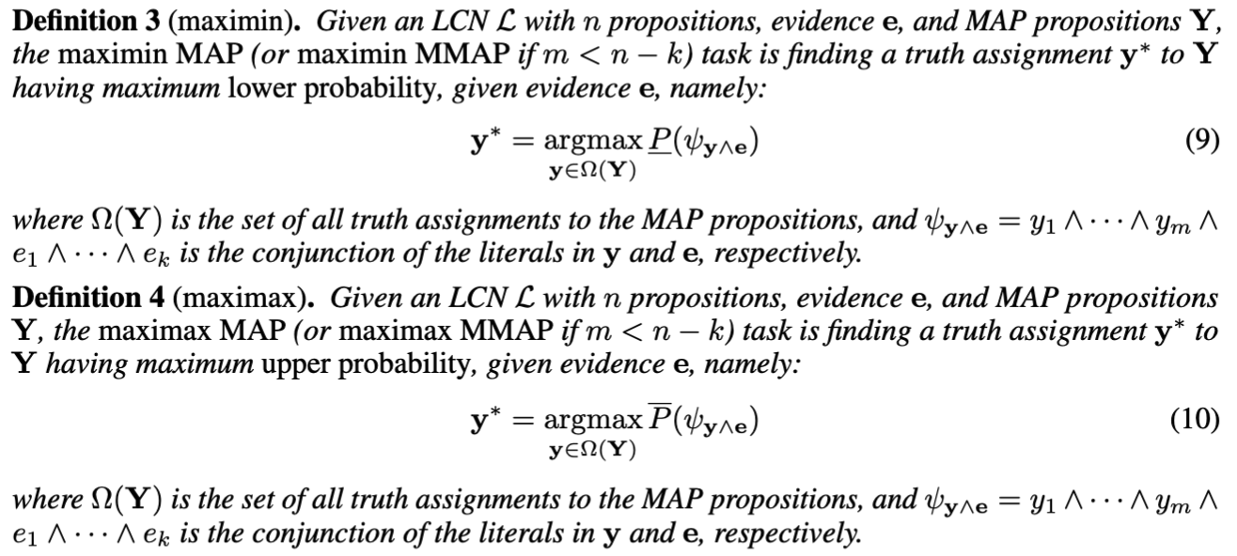
MAP and MMAP Tasks in LCNs
Define maximin and maximax MAP/MMAP tasks as follows:

Slide 31
Exact MAP/MMAP Algorithms
Depth-First Search (DFS)
Depth-first search traversal of the search space defined by the MAP propositions $Y$
At each leaf node $y$, evaluate exactly the lower probability of the query formula $ψ_{y∧e}$ i.e., $y_{1}∧…∧y_{k}∧e_{1}∧…∧e_{m}$
Return the optimal configuration $y^{∗}$ with maximum lower probability.
Limited Discrepancy Search (LDS)
Depth-first search traversal with max discrepancy $δ≥1$ [Harvey and Ginsberg, 1995]
As before, evaluate exactly the lower probability of the query formula $ψ_{y∧e}$
Return the best configuration $\hat{y}$ found so far
If max discrepancy $δ=|Y|$ then LDS is optimal, namely returns $y^{∗}$ with maximum lower probability.
Simulated Annealing (SA)
Stochastic local search-based traversal of the MAP search space
For each configuration y evaluate exactly the lower probability of the query formula $ψ_{y∧e}$
SA converges to the optimal solution if the temperature decays slowly enough

Slide 32
Approximate MAP/MMAP Algorithms
Approximate MAP (AMAP)
Message-passing scheme
Extends ARIEL scheme to approximate lower/upper probability of a MAP configuration
Using an augmented LCN (more details in [Marinescu et al, NeurIPS 2024])
Approximate Limited Discrepancy Search (ALDS)
Traverse the MAP search space using LDS($δ$)
Estimate the lower probability of each MAP configuration using AMAP
Keep track of the configuration with the largest estimate
Approximate Simulated Annealing (ASA)
Traverse the MAP search space using SA
Estimate the lower probability of each MAP configuration using AMAP
Keep track of the configuration $\hat{y}$ with the largest estimate
No guarantees regarding optimality nor we can guarantee lower/upper bounds

Slide 33
Outline
Motivation and Contribution
Background: Probabilistic Logic
Logical Credal Networks
Inference
Experimental Results
Conclusion
Code* available at: http://github.com/IBM/LCN
*needs a bit more TLC ☺

Slide 34
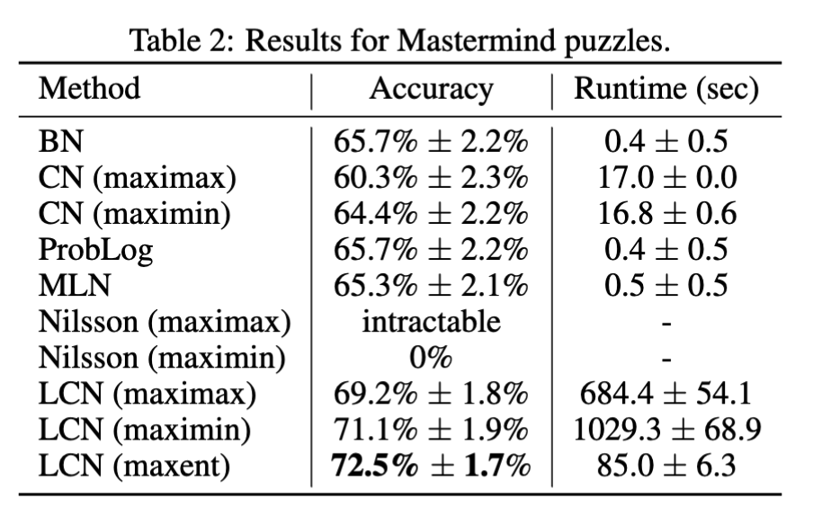
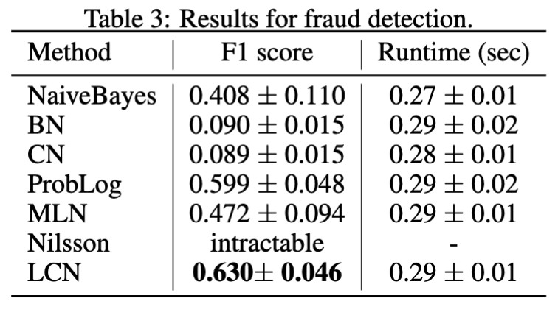
Results – Exact Inference
[Marinescu et al., NeurIPS 2022 ]
Benchmark problems:
Random LCNs
Mastermind puzzles with uncertainty (code-maker lies)
Credit card fraud detection application (with additional imprecise expert knowledge)

Slide 35
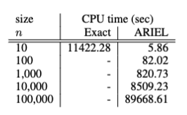
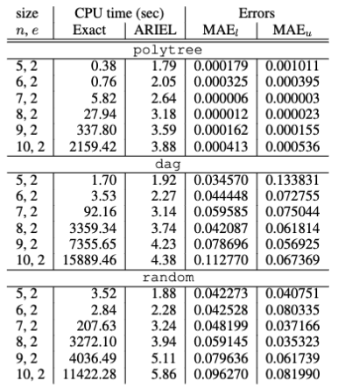
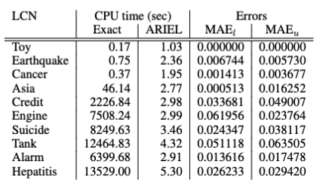
Results – Approximate Inference
[Marinescu et al., IJCAI 2023 ]
Benchmark problems:
Random LCNs
LCNs derived from real-world Bayesian networks
Large LCNs
Random LCNs
Real-world LCNs

Slide 36
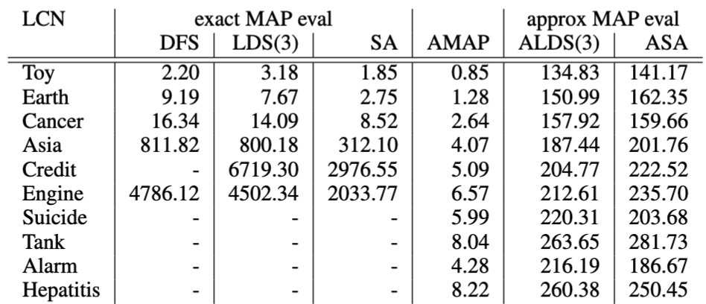
Results – MAP Inference
[Marinescu et al., NeurIPS 2024 ]
Benchmark problems:
Random LCNs
LCNs derived from real-world Bayesian networks
Real-world LCNs

Slide 37
Conclusion
New probabilistic logic that expresses probability bounds for propositional and first-order logic formulas with few restrictions
Local Markov condition (like in probabilistic graphical models) allows making additional independence assumptions
Restricts the space of probability distributions to enable meaningful representations of uncertainty
Exact inference (marginal, MAP) to answer queries for the new formalism
Involves the solution of a non-linear constraint program
Approximate inference (marginal, MAP) scales to larger problems
Involves message-passing along the edges of a factor graph
Empirical evaluations on random problems and more realistic applications shows promising results, particularly in aggregating multiple sources of knowledge

Slide 38
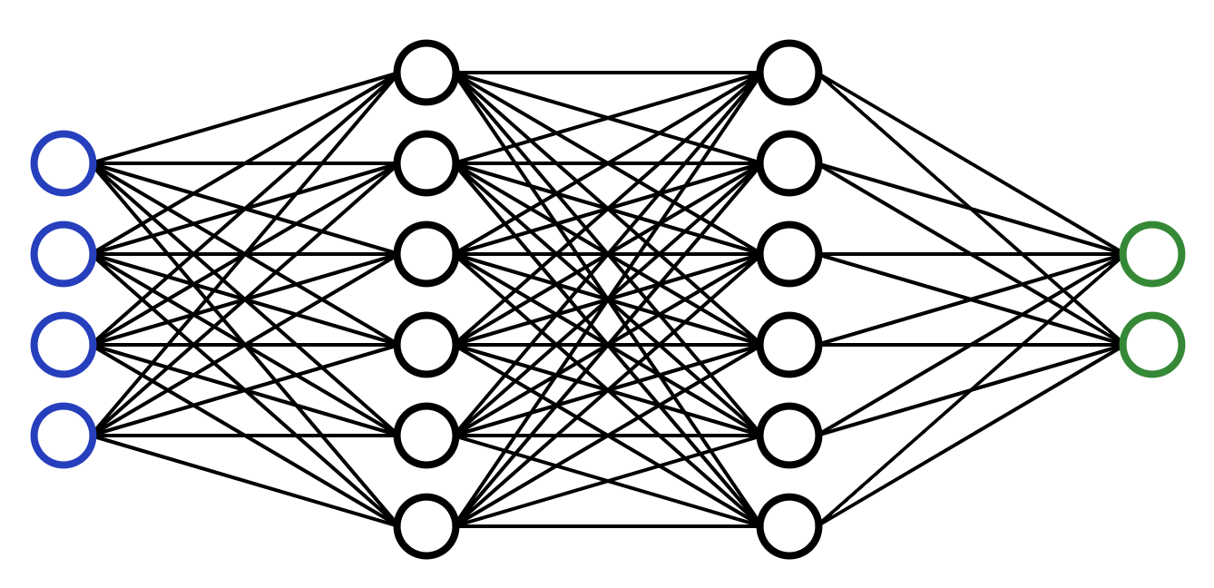
Extension: Neural Message-Passing
$$f_{1}$$
$$0.2≤P\left(a\right)≤0.3$$
$$a$$
variable-to-factor: $[l_{v→f},u_{v→f}]$
$$f_{2}$$
$$0.6≤P\left(b|a\right)≤0.7$$
$$0.1≤P\left(b|¬a\right)≤0.2$$
$$l_{v→f}=\max_{f^{′}∈N\left(v\right)∖\{f\}}{l_{f^{′}→v}}$$
$$b$$
$$u_{v→f}=\min_{f^{′}∈N\left(v\right)∖\{f\}}{u_{f^{′}→v}}$$
$$f_{3}$$
$$0.3≤P\left(b\right)≤0.4$$
factor-to-variable: $[l_{f→v},u_{f→v}]$
Approximate with a Neural Network
$$\sum_{i=1}^{K}{p_{i}=1}$$
$$p_{i}≥0, ∀i=1,…,K$$
Hard to evaluate!
$$l_{q}≤A_{q}⊙\overline{p}≤u_{q}$$
$$l_{f→v}$$
$$l_{q|r}A_{r}⊙\overline{p}≤A_{q∧r}⊙\overline{p}≤u_{q|r}A_{r}⊙\overline{p}$$
$$u_{f→v}$$
$$A_{v^{′}∧v^{′′}}⊙\overline{p}=\left(A_{v^{′}}⊙\overline{p}\right)\left(A_{v^{′′}}⊙\overline{p}\right), ∀v^{′}≠v^{′′}∈N(f)$$
minimize/maximize $A_{v}⊙\overline{p}$
e.g., [Razeghi et al., IJCAI 2021]

Slide 39
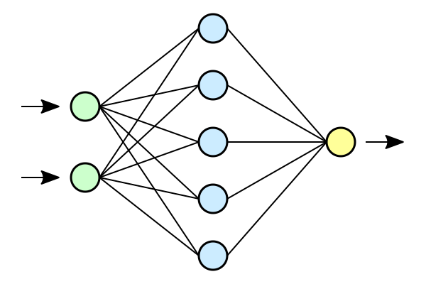
Extension: Deep Logical Credal Networks
For now, assume “precise LCNs”, namely $P\left(q\right)=α$ and $P\left(q | r\right)=β$
In this case, the probability distributions are represented by deep neural networks
$$P\left(b\right)=0.2$$
$$b$$
$$e$$
$$P\left(e\right)=0.1$$
$$b∨e$$
$$a$$
$$P\left(a | b∨e\right)=0.9$$
$$¬(c⊕d)$$
$$P\left(¬(c⊕d) | a\right)=0.8$$
$$P\left(a\right)=0.08$$
$$c$$
$$d$$

Slide 40
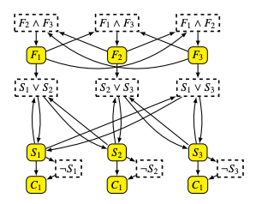
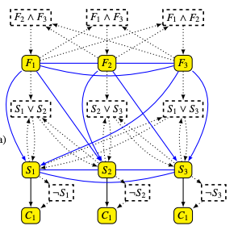
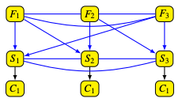
Markov Conditions and Factorization in LCNs
[Cozman et al, IJAR 2024]
Definition: the structure of an LCN
Build the primal graph of the LCN
Add undirected edges between pairs of atoms in $q$
Add directed edges from each atom in $r$ to each atom in $q$
Replace bi-directed edges between two atoms by un-directed edge
Remove formula nodes and their corresponding edges
structure
primal graph
structure

Slide 41
Markov Conditions and Factorization in LCNs
[Cozman et al, IJAR 2024]
The LCN structure reveals interesting properties (assuming positive probabilities):
If the structure is a DAG, then the LCN admits the same factorization as BNs/CNs.
If the structure has no directed edges, then the LCN admits the same factorization as Markov Networks
If the structure is a chain graph, then the Markov condition for LCNs is equivalent to the Markov condition for chain graphs
i.e., a node is A is independent, given its parents, of all other nodes that are not A itself, nor descendants nor boundary nodes of A
LCNs with these kinds of structures admit the same factorization as chain graphs
Factorization is useful for learning LCNs because it implies specifying fewer parameters for the joint distributions
Open question: the structure contains directed cycles. Is there a factorization?

