Slide 1
Making archived social media data accessible for research
Michael Kurzmeier, C21 Editions Project

Slide 2
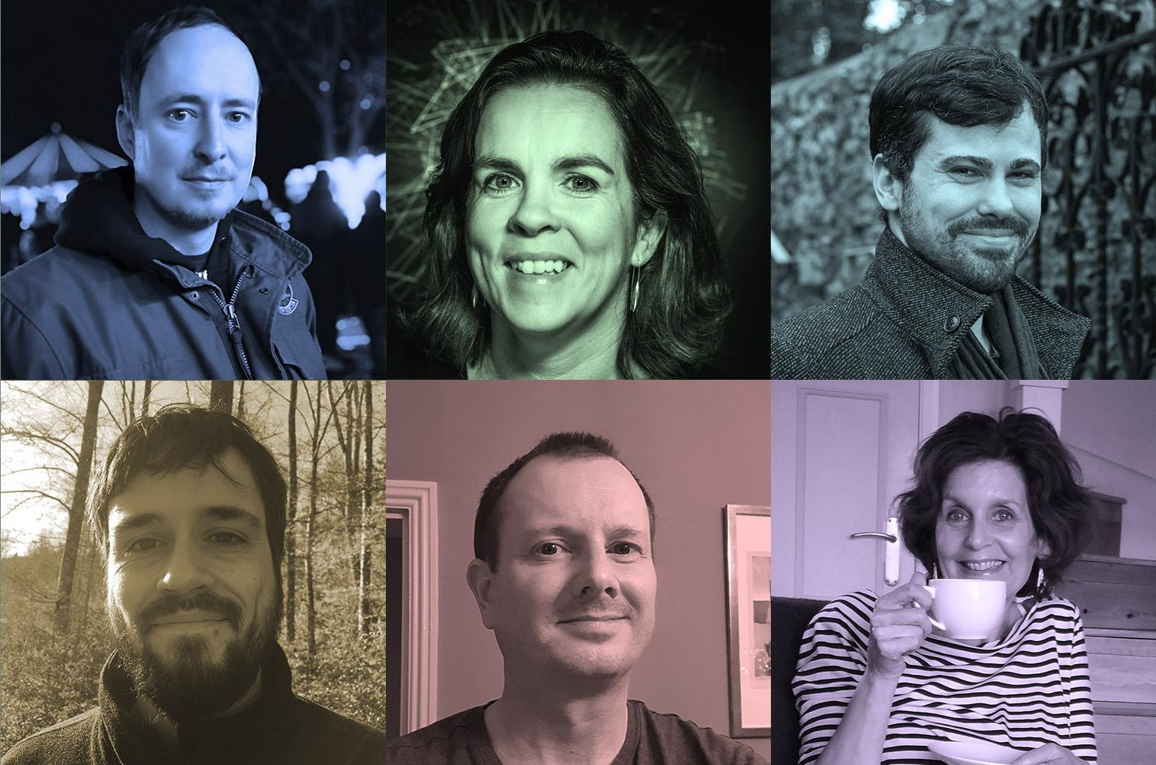
About
Scholarly Editing and Publishing in the Digital Age
The aim of the C21 Editions project is to advance the practice of scholarly digital editing by researching and prototyping data standards that will enable editions to accommodate born-digital content.
Dr. James O’Sullivan Principal Investigator (Ireland)
Michael Pidd Principal Investigator (UK)
Digital Humanities Institute, University of Sheffield
Dr. Órla Murphy Co-Investigator (Ireland)
Department of Digital Humanities, University College Cork
Prof. Bridgette Wessels Co-Investigator (UK)
School of Social & Political Sciences, University of Glasgow
Jamie McLaughlin Research Software Engineer (UK)
Digital Humanities Institute, University of Sheffield
Notes:
Little bit about me - humanities degree, DH phd.
Explain the project approach
Need to cover some concepts from humanities and textual scholarship

Slide 3
Intro
Definitions
Edition
Digital Edition
“Make accessible”
Current methods, current problems
Example workflow, data structure and presentation mode
Context and outlook

Slide 4
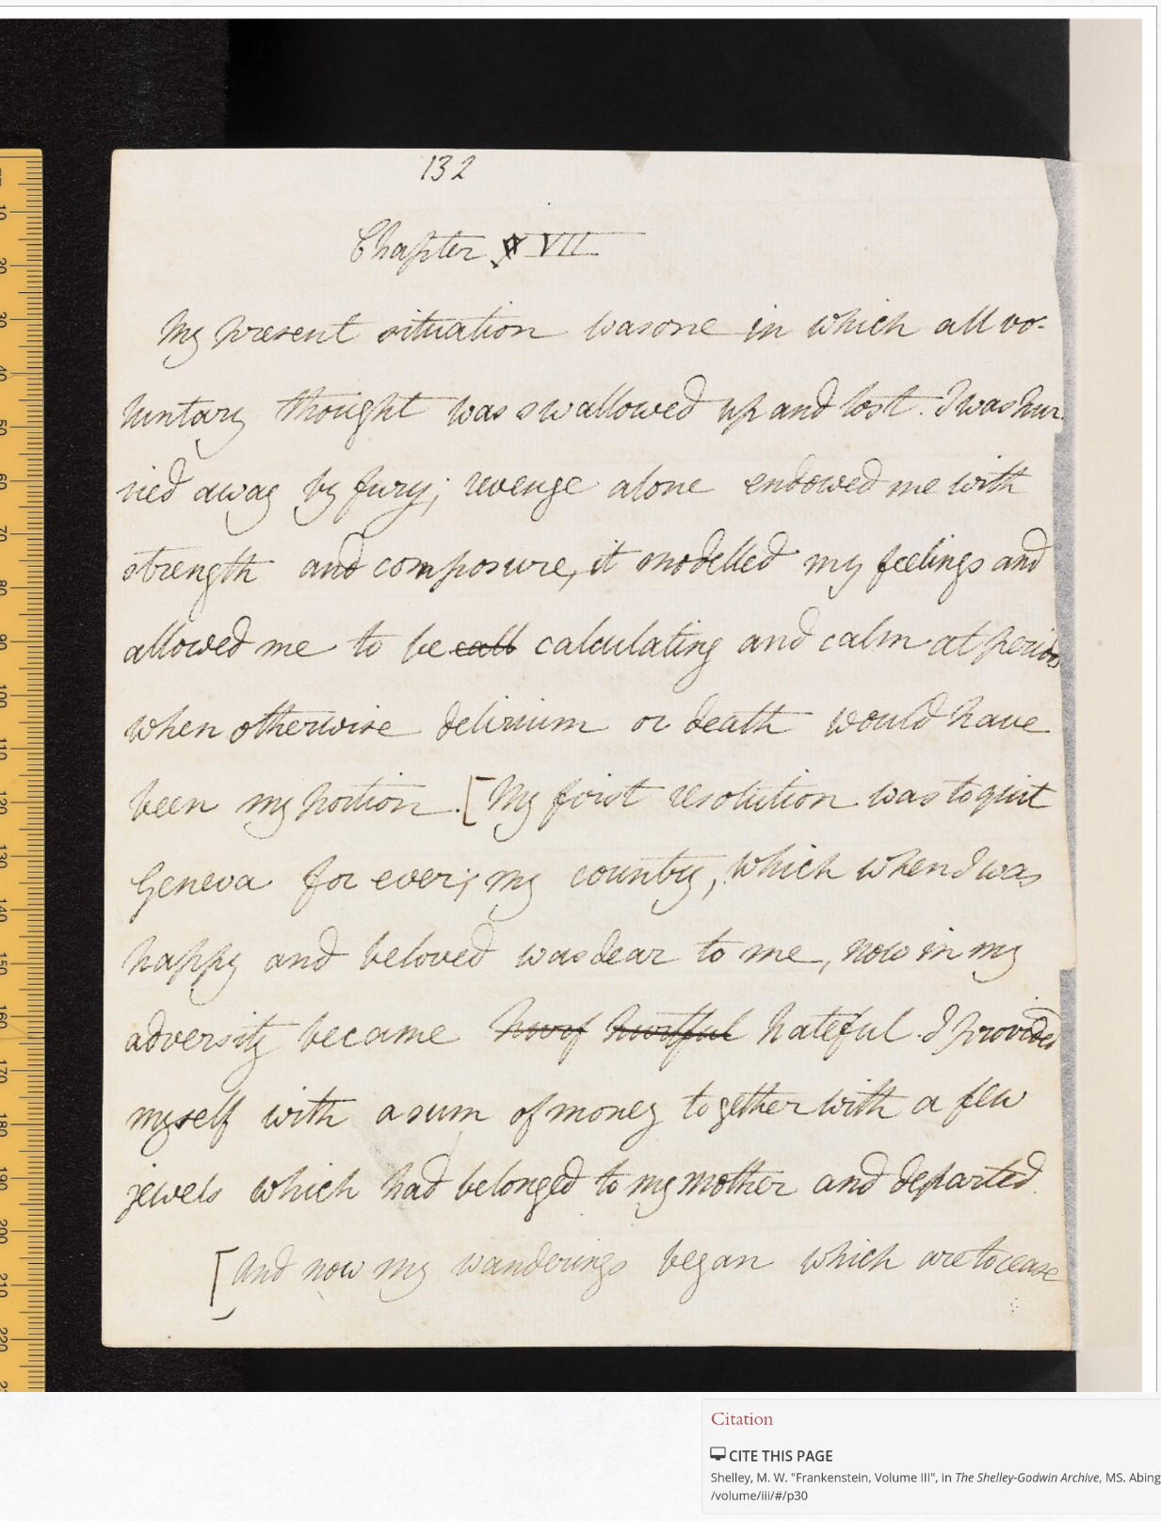
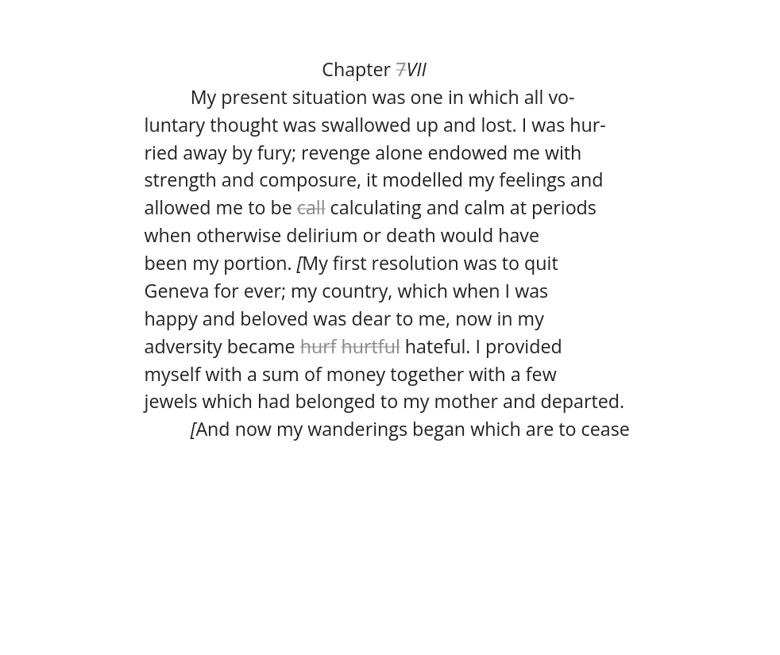
Scholarly Editions
A scholarly edition is a scholarly enriched of a text that
is prepared by an editor or team of editors
in line with the edition objectives
It is usually based on a critical examination of all available sources.
Notes:
A scholarly edition is a scholarly enriched of a text that is prepared by an editor or team of editors in line with the edition objectives It is usually based on a critical examination of all available sources.
Breakdown:
Scholarly enriched: information is added. In this example, a transcription is added ( there is more that we cover later)
Prepared by an editor: Subject matter experts make documented decisions on the text. They evaluate sources, order and describe them.
Edition objectives: Classic example on an edition is textual transmission of texts that were copied over long periods of time. Also complex drafts and multiple editions can be included. If that is the objective, it is important to show the transmission history of every document. Other objectives might exist as well, as we will see with born-digital content.

Slide 5
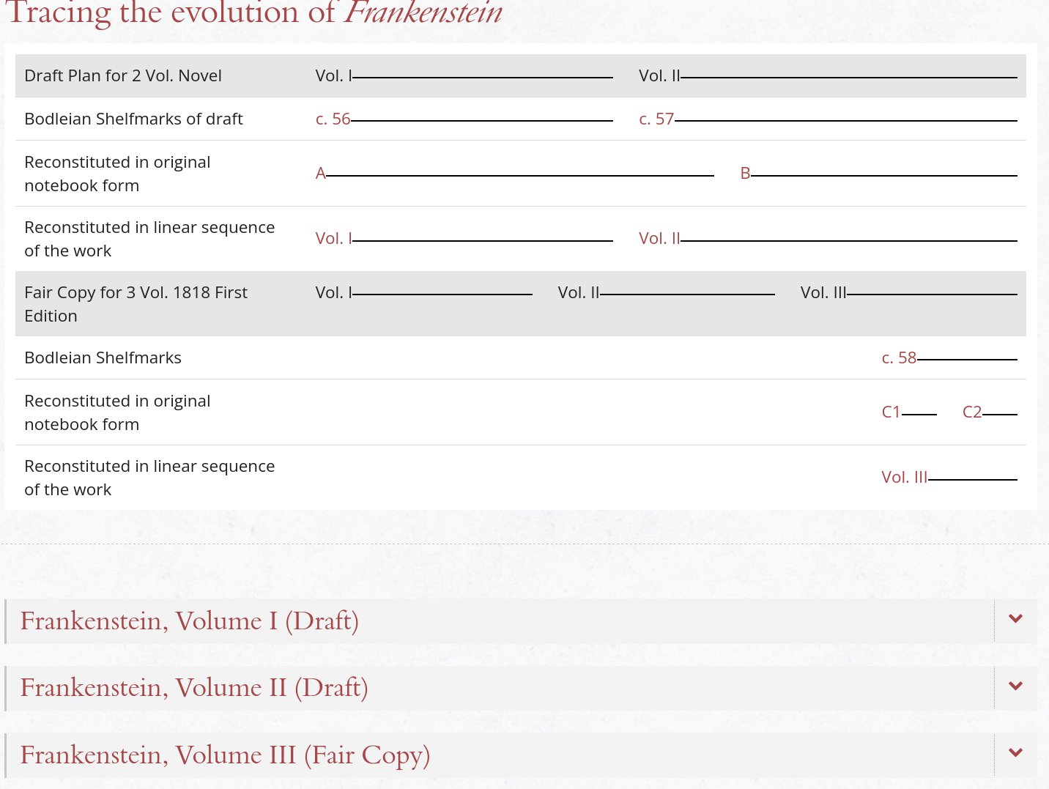
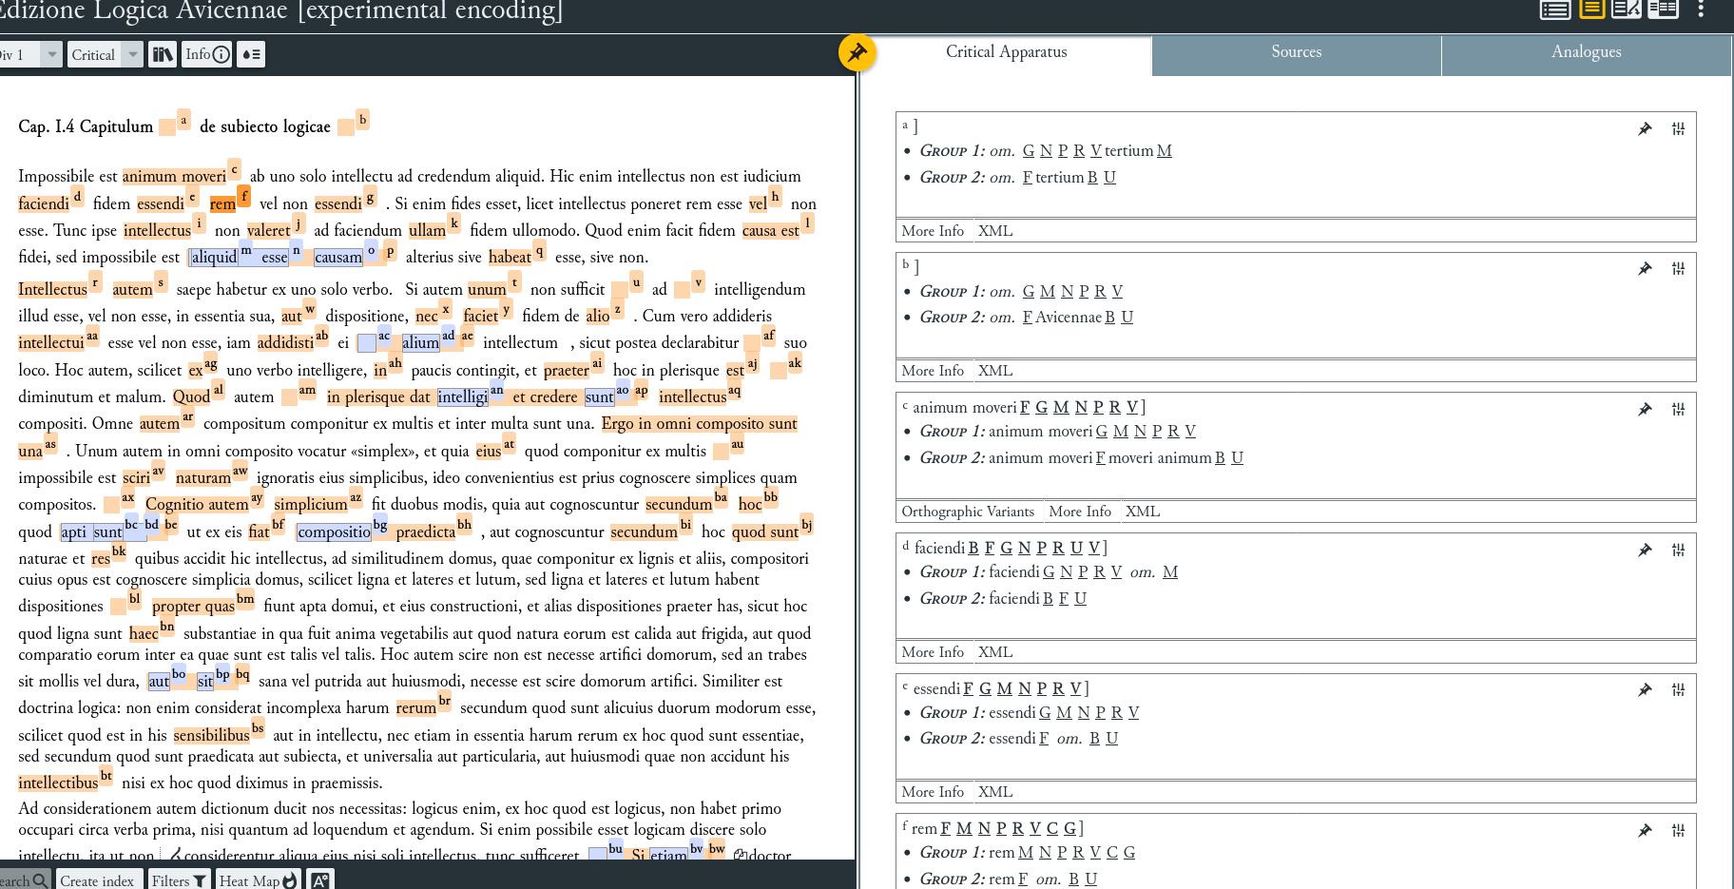
Scholarly Editions
… is usually based on a critical examination of all available sources …
Notes:
Explains sources
Evaluates sources
Contextualize sources
Different types of sources need different methods

Slide 6
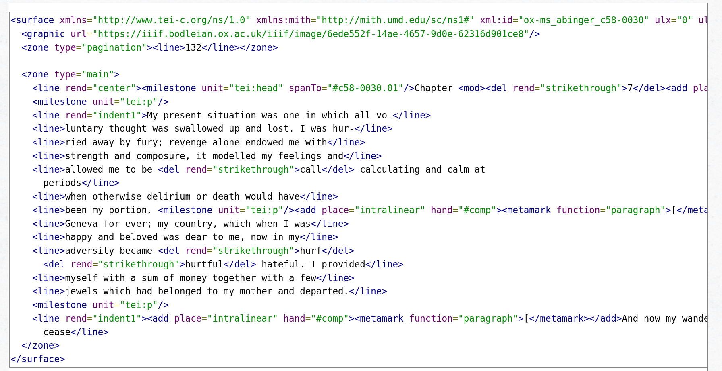
Scholarly Editions -technical background
Notes:
Techniques and methodology have been developed for printed/written text.
TEI- TExt encoding initiative is an XML-based encoding schema.
It allows for custom tags and attributes
Easy to use and learn, flexible and low-resource

Slide 7
Digital or digitized edition?
“A digital edition cannot be given in print without significant loss of content and functionality.”
Sahle, Patrick. 2016. “What Is a Scholarly Digital Edition?” In Digital Scholarly Editing: Theories and Practices, edited by Matthew James Driscoll and Elena Pierazzo, 19–40. Open Book Publishers. https://doi.org/10.11647/OBP.0095.02.
Digital Paradigm:
Search functions
Reconfiguration of material
Time-based media
Interactivity
Bi-directional communication
Notes:
Baseline for evaluation is the print test
Other features also possible

Slide 8
Two important concepts
The ideal text
The ideal text is an abstraction. Through many witnesses (documents), it is possible to describe it more and more accurately.
But: No single ideal text in social media
2. Linear text
Linear text is read from the beginning to the end. The sequence structures the content. (Intro-Body-Conclusion)
But: Does not even apply well to hypertext
Notes:
In practice, a lot of SE methods and tools come from
a
Textual studies - interested in the transmission of text and the relation of documents to each other
B
Made for relatively stable printed or written documents
Also, SE can handle scarcity better than abundance

Slide 9
A digital scholarly edition (DSE) is the scholarly enriched representation of historic documents within the digital paradigm.
Archive
Digital Scholarly Edition (DSE)
Collection
Repository
Notes:
A DSE has elements of these three, but sits in the middle

Slide 10
A digital edition of social media data
Acquire and stabilize
Select and enrich
Present
Receive data from a web archive or run custom crawler
Encode material in line with edition objectives
Make the material accessible and allow users to interact with it in productive ways, including interoperability.
Notes:
This is our workflow, we will go through each step and describe the details

Slide 11
Acquire and stabilize
Objective: Stabilise material by converting it from a live social media post into a static object
Most social media platforms are unarchiveable by design
Balance ethics and crawl depth
Example: Twitter API and re-use of Tweets
Notes:
The material is to be encoded in line with a developed XML schema for social media content. The encoding is to allow:
Representation of multiple sources in one edition, sources meaning both different platforms as well as different methods of data acquisition
Clear indication of crawl method and time
To be as platform-agnostic as possible while still capturing the essence of the platform interactions
Walled gardens
Data is business asset
Example: link shorteners
Consider crawl depth

Slide 12
Acquire and stabilize
Select and enrich
Encode material in line with edition objectives:
Enrich and contextualise the material through editing and annotation
Representation of multiple sources in one edition, sources meaning both different platforms as well as different methods of data acquisition
Clear indication of crawl method and time
To be as platform-agnostic as possible while still capturing the essence of the platform interactions
Notes:
I have mentioned digital editions’ reliance on methodologies designed for linear text. Implied in this debate is the question of whether to opt for the adaptation of a TEI-schema or to start a new development which will be incompatible with existing systems. The choices made in relation to the encoding of data are in line with the stated use cases and the encoding objectives:
The encoding structure curates the data in line with use case objective A - it stabilises the material by converting it from a live social media post into a static object
The encoding structure treats these converted elements not as a linear text, but as objects which can be flexibly re-arranged, enriched and contextualised (Objective B). It allows TEI elements to be used within the structure, yet it is in its entirety not a TEI schema.
The encoding structure acknowledges through its design that algorithmically curated feeds do not have one, but many ideal texts. It accounts for this by providing linked information on the data source and the crawl/access time.
The number of platform-specific elements is deliberately reduced to facilitate a multi-source approach over the accurate recreation of one platform.
The encoding structure uses a minimalist approach - it aims to encode what is necessary using the simplest structure.

Slide 13
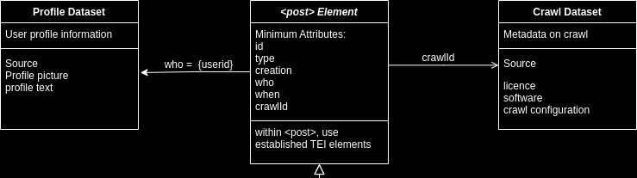
Acquire and stabilize
Select and enrich
Notes:
The minimum attributes in <post> identify:
The element ID. This is internal to the edition and used and as an identifier
The type of post. This can be used to identify the platform, can also indicate a standalone post or retweet, reply, etc. Where the type of post refers to another post, the ID must be provided.
The creation by a user, a bot or the system.
A unique identifier for the account which links to a dataset with information on the user profile at the time of the crawl. This dataset may be a relational database, or XML-encoded information.
The creation time and date.
The crawlId which links to the crawl dataset. This dataset holds metadata about the data source and helps describe the available data. This dataset can also take any form that is relevant to the research project and the scope of the edition.
Within the <post> element, TEI elements can be used as necessary. For example, images can either be described as a whole, or parts of images can be annotated using the existing <zone> element. This enables individual projects to define relevant elements through the extensive library of TEI elements.
The profile dataset describes the user profiles belonging to the posts. As a minimum, the profile dataset includes the profile picture and text at the time of the data collection, as well as a reference to the data source. The level of detail here is platform and use-case specific, but at a minimum should provide enough information to contextualise the post at the time of capture. In the case of the C21 Editions project, this profile dataset was realised through XML-encoded data, but a number of solutions such as JSON arrays or relational databases are possible.
Finally, the <post> element refers to its own datasource through the crawlId attribute. The crawl dataset holds general information about the data source such as the way data was acquired (through manual collection, data export, a crawler, etc). It further provides information about the licence the data falls under. This can be used to account for platform-specific limitations on the usage of data. The data structure allows multiple data sources to be used alongside each other, including data with different usage rights and restrictions. As in the case of the profile dataset, this crawl database can be realised using structured markup or relational databases as needed for the scope of an edition.

Slide 14
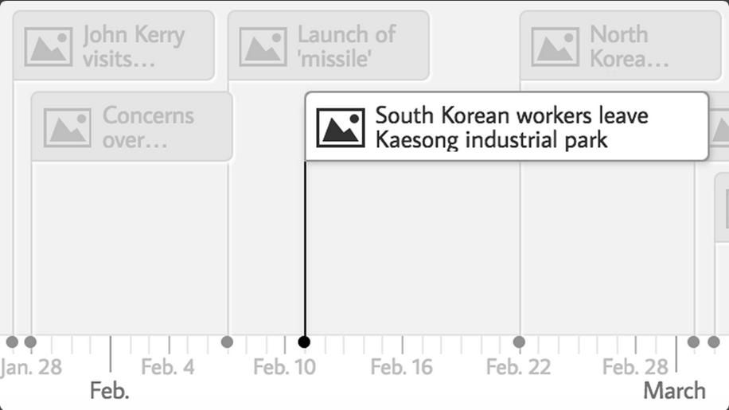
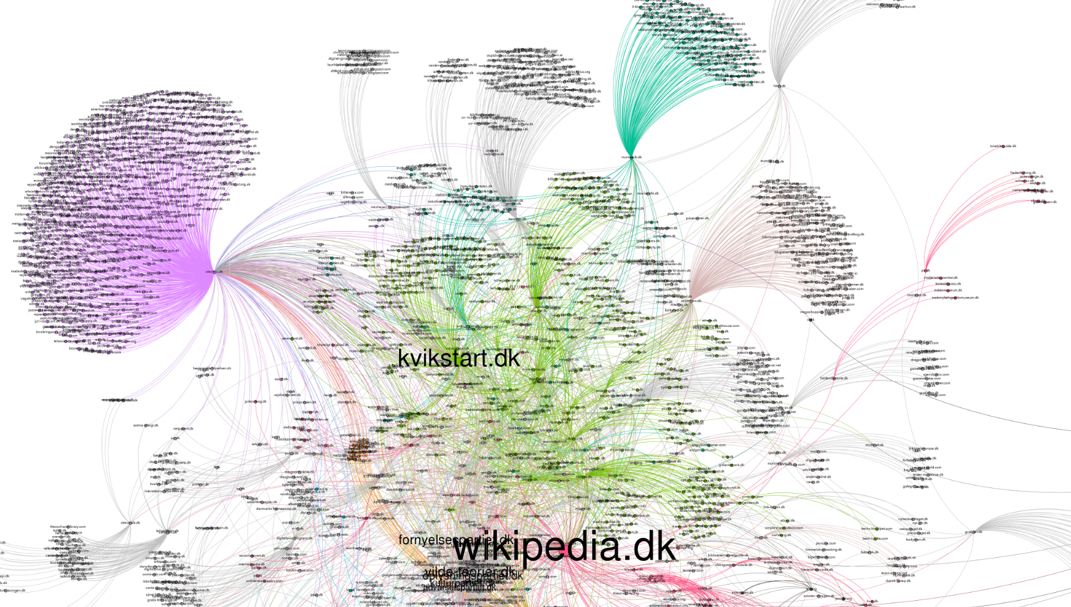
Acquire and stabilize
Select and enrich
Present
Notes:
Two different approaches here
Timeline, which treats the timestamp as the smallest common denominator for the data and presents on a linear scale
Works for small data sets
Combine with other sources
Network (graph_presenter deep zoom tool)
Allows zooming and tiling
Nodes can be highlighted by clicking on them
Good for large datasets
Combination of the two also possible, timeline showing the changes in a network.

Slide 15
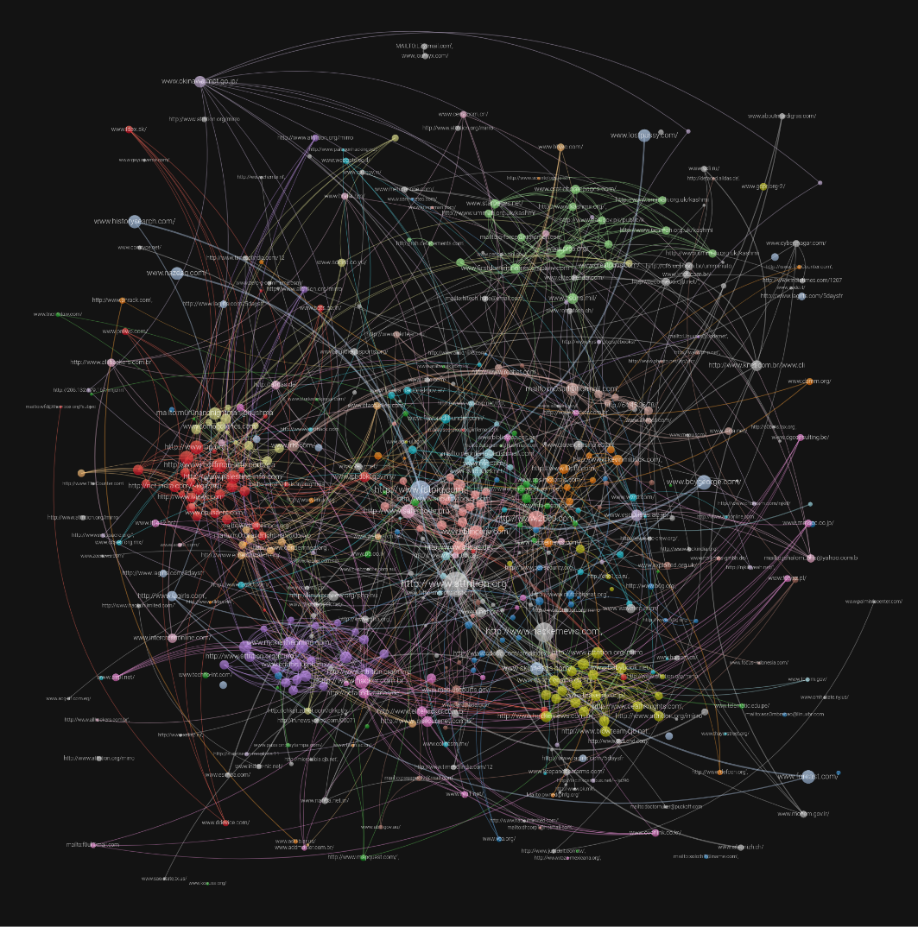
The larger picture
Notes:
There is low interoperability with DSE that only focus on text - what is the value if sources are incompatible?
Not very complicated on a small scale - but how to advise on a structure that can be used for interoperable DSEs? How do we balance ethics on such a large scale?
Building a digital edition from archived social media content brings additional challenges, as the outlined workflow has shown. These challenges are largely rooted in the incompatibility of tools and methods for digital editions with archived social media data.
Regarding tools, no widely accepted model for the annotation of archived web content in general exists. Where solutions are available, they generally struggle to capture time-based media, interactive environments and mobile-specific content such as apps.
While developments exist, new solutions are difficult to integrate with existing tools such as TEI schemas. Regarding methods, editions face even greater challenges. In the majority of cases, social media content is curated through an algorithm. This means there is no single ideal text or work to be reconstructed, as the text a user experiences is highly personalised.
While it is still possible to arrive at data-based insight into the dominant content in a social network for a certain time and user base, tools which have been developed for the analysis of linear text struggle with the analysis of algorithmically curated hypertext.
Levels of data access also present a significant challenge to the creation of an edition from archived social media content. The idea of extracting data from a social media platform to transform it into an edited element is at odds with the data capitalist business model of social media platforms. This and the above-mentioned automated curation make it difficult to apply traditional editing techniques. At the same time, a sample workflow such as the one described in this paper must aim for interoperability with existing workflows where possible.
The solution presented here is a data scheme which is centred around the social media element and accounts for multiple data sources. The encoding scheme is as open as possible, allowing all TEI elements to be used without itself being based on hierarchic markup. Through the combination of hierarchical XML-based markup and relational databases, edited social media elements can be reconfigured through a frontent solution, so that multiple editions are possible from one set of encoded elements.
The presentation of these editions can also be chosen to represent the scale and scope of the edition. Two examples were presented, one timeline-based solution which understands the chronological sequence of elements as their unifying characteristic, and a directed network graph which visualises relations between elements.
These interfaces are understood to provide users with a way to navigate and explore the edition, while individual elements can be presented in a range of ways ranging from deep zoom to XSL transformations.
Through providing this workflow example, problems in creating a digital edition from archived social media content were illustrated, and sample solutions provided. These solutions were designed with the aim to be as inclusive and open as possible, while providing appropriate methods to encode born-digital content. Additionally, the workflow example provided a framework for creating digital editions that can be adapted to fit the needs of any project.
Thanks
I hope I was able to give you some insight into what we do and what the challenges are that we are working on.
If you want to continue this conversation or like to learn more about the project…

Slide 16
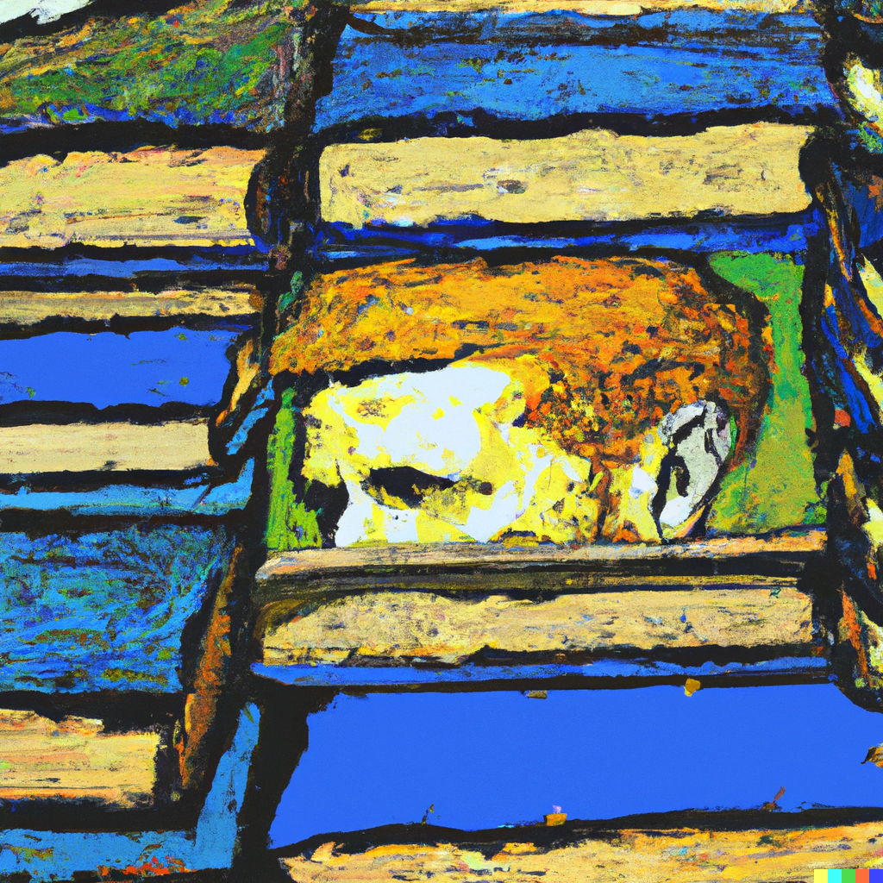
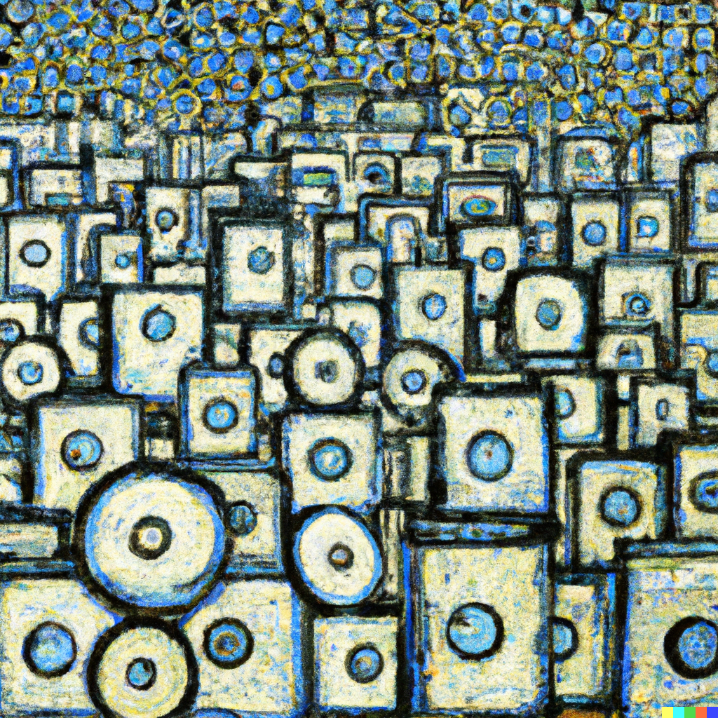

Slide 17
“This is a super-important quote”
- From an expert

Slide 18
This is the most important takeaway that everyone has to remember.

Slide 19
Thanks!
Contact us:
https://www.c21editions.org/
@kurzmeier@scholar.social
Visualizing digital scholarly editions

