Slide 1

Optimized Techno-Economic Analysis of the Combined Photovoltaic and a Novel Renewable Energy Systems for Mining Industry Applications
Eduardo Vyhmeister B.

Slide 2
Summary
Introduction
Bound4Blue
Natural Resources Fluctuation
Methodology
Results

Slide 3
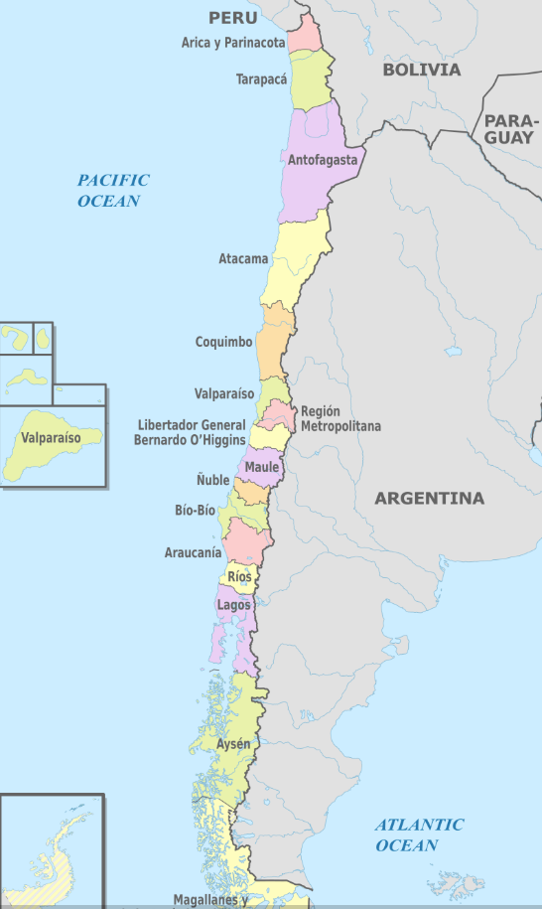
Introduction: Principal Gross Domestic Product Chile
Mining - ~20% GDP
Pits at a height of 2000 m above sea level
Electricity is mainly supplied by the North Interconnected System
Wine - ~ 2.5% GDP
Agriculture - ~5% GDP
Salmon and Forestry ~10% GDP

Slide 4
Introduction: Mining in Chile
Mining is the largest economic sector in Chile and the considerable energy requirements represent 20% to 50% of the operating costs.
The industry is heavily dependent on other countries for the supply of this demand.

Slide 5

The Problems
Electricity comes from coal 49%, natural gas 37%, diesel 9% and renewable energy 5% (2017)
Greenhouse Gas Emission
Mining location in arid sector (Regional irradiation indexes range from 5 to 12 kWh/m²)
Relative low wind speed velocity in the sector (Historical record of 4 m/s)
Constant increase of the production (3.8%) 3,108.358 kTons/year of fine material produced in the region (1,453.22 MW)
?
?
?

Slide 6
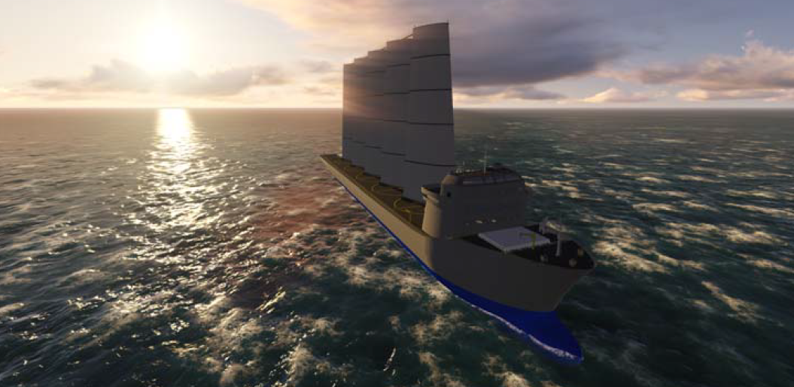
Bound4Blue

Slide 7
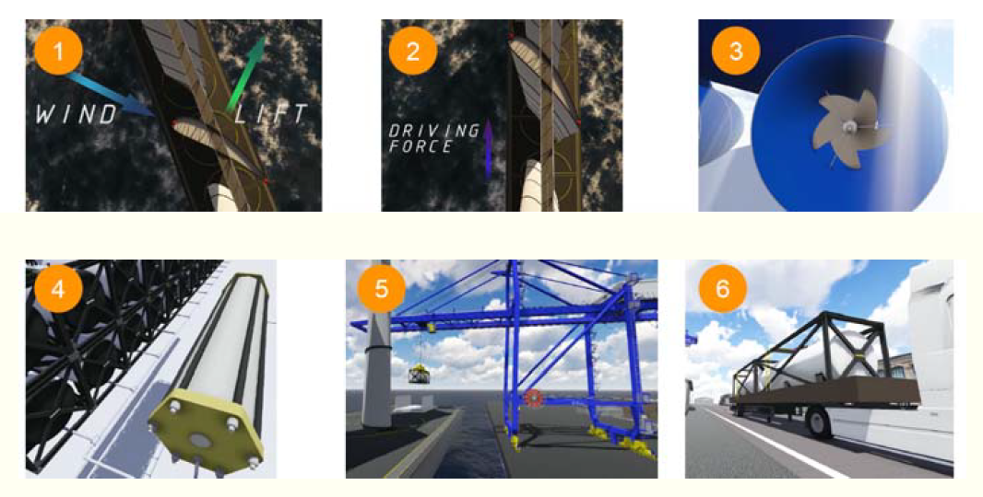
STEPS OF THE PROCESS
efficient rigid wingsails
Ship’s relative velocity is obtained by considering a force
balance between positive and negative forces
hydroturbines to transform the
higher-density kinetic energy
electrolytic system to produce hydrogen (H2)
and oxygen (O2) from seawater.
The H₂ and O₂ are stored and transported to port where they can be used or sold as a final product.
H₂ and O₂ must be transformed again into electrical energy in a plant located close the port to avoid expensive pipelines

Slide 8
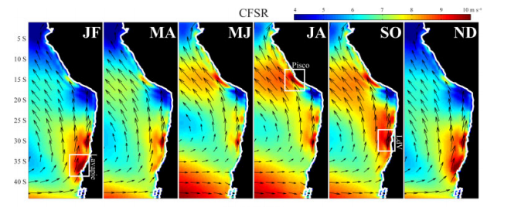
Problems with Fluctuations of Natural Resources Energy
Rahn, D.A., and Garreaud, R.D., 2013, A Synoptic Climatology of the Near-Surface Wind Along the East Coast of South America, International Journal of Climatology.

Slide 9

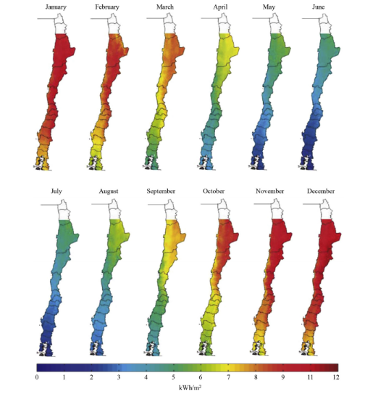
Alternative!!!!!!!!!!
Evaluate the BEST combination of boats and solar panels. To supply the 10% of the energy requirements of the mining industry in the Antofagasta region

Slide 10
Process Diagram
Bound4Blue
Photovoltaic Energy
Boat Speed Evaluation
Temporal Effects Evaluation
Boat Route Determination
Derating Factor Evaluations
Energy Production Evaluation
Energy Production Evaluation
Optimization Problem Formulation in Function of Industry Requirement and Restrictions (20 years evaluation)

Slide 11
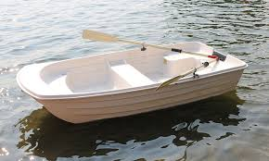
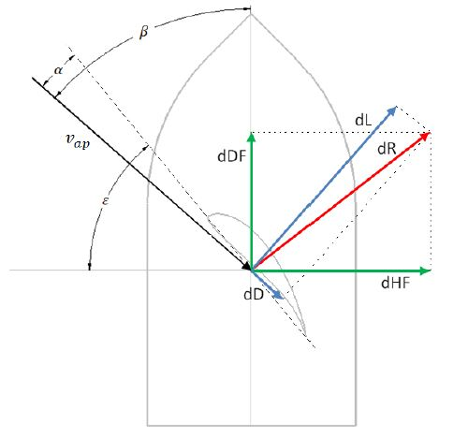
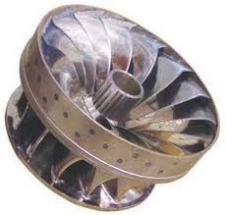


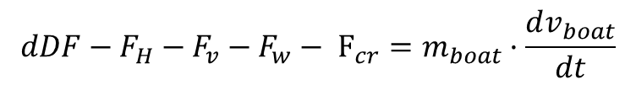
Bound4Blue: Boat Speed Evaluation
$$dDF−F_{H}−F_{v}−F_{w}− F_{cr}=m_{boat}·\frac{dv_{boat}}{dt}$$
Driving Force
Boat Resistance
Turbine Dragg Force
Viscous Resistance
Wave Resistance
dL, dD, dH, dR, and dDF are the lift, drag, healing, resulting aerodynamic, and driving (projection of the aerodynamic resulting force to the motion direction) forces, respectively.

Slide 12
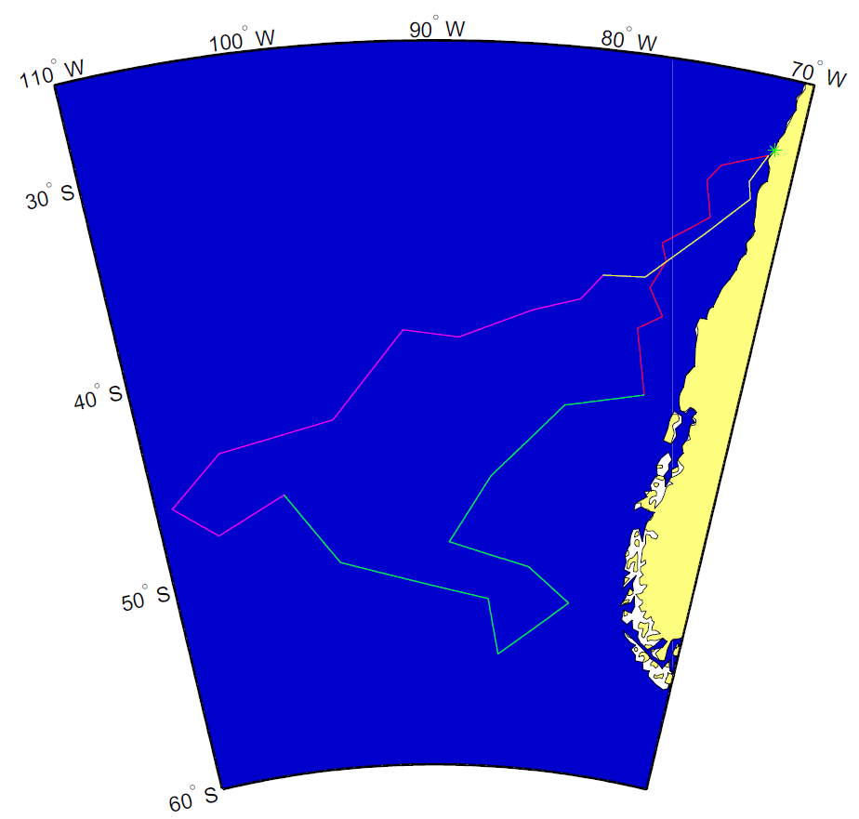
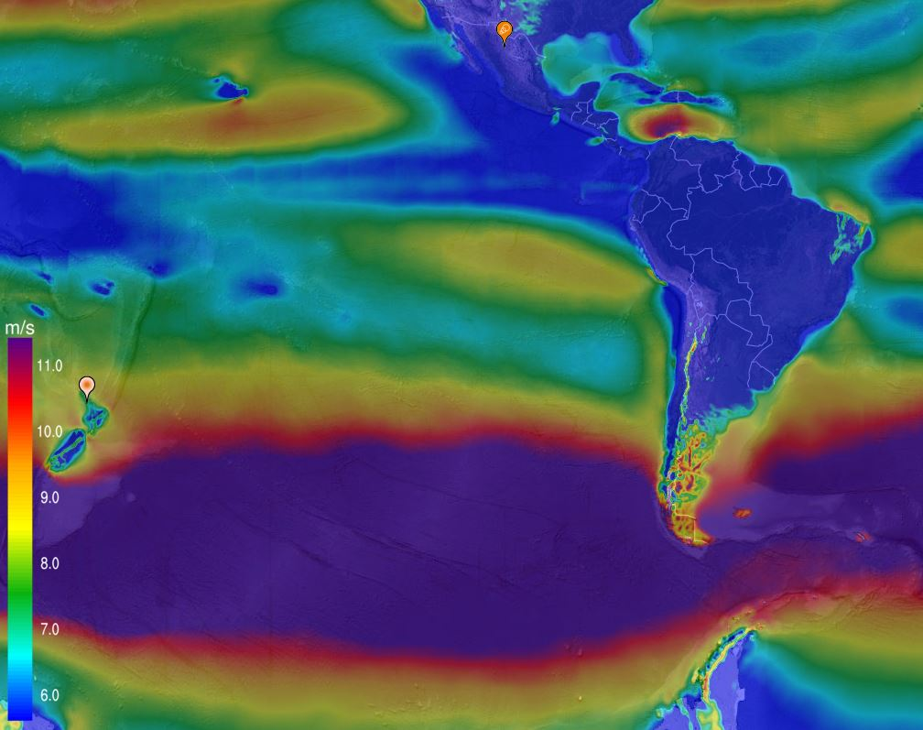
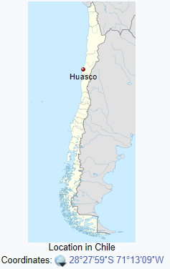
Bound4Blue: Route Determination
Optimization problem that uses NOA information and instantaneous information
Optimization limited to a starting point. Huasco Port
Objective function = shortest time to fill the tanks (maximum distance travelled)
Wind time-dependence considered.
Ship to big for other ports.
Dynamic calculation every 6 hour of travelling
69 days route

Slide 13
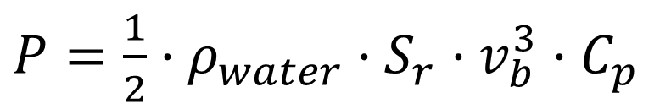
Bound4Blue: Energy Production Determination
$P=\frac{1}{2}·ρ_{water}·S_{r}·v_{b}^{3}·C_{p}$
S_{r} = Cross section Turbine Surface (78,53 m²)
C_{p} = Turbine Power Coefficient (0.6)
V_{b} = Boat Velocity
Added a 5% loss due to mechanic to electric conversion
Added a 4,65 KWh/Nm³ H₂ Electrolyser efficiency
Polymer Electrolyte Membrane electrolysis (need pure water i.e. water purification system)
2.5% of the electrical energy used in the boat electrical components
Other efficiency added (e.g. gas compression, port working days)
1 route =2,96 ·10⁶ Nm³ (266 Tn) of hydrogen and 1,48·10⁶ Nm³ (2.115 Tn) of oxygen
67,616 MWh/year

Slide 14
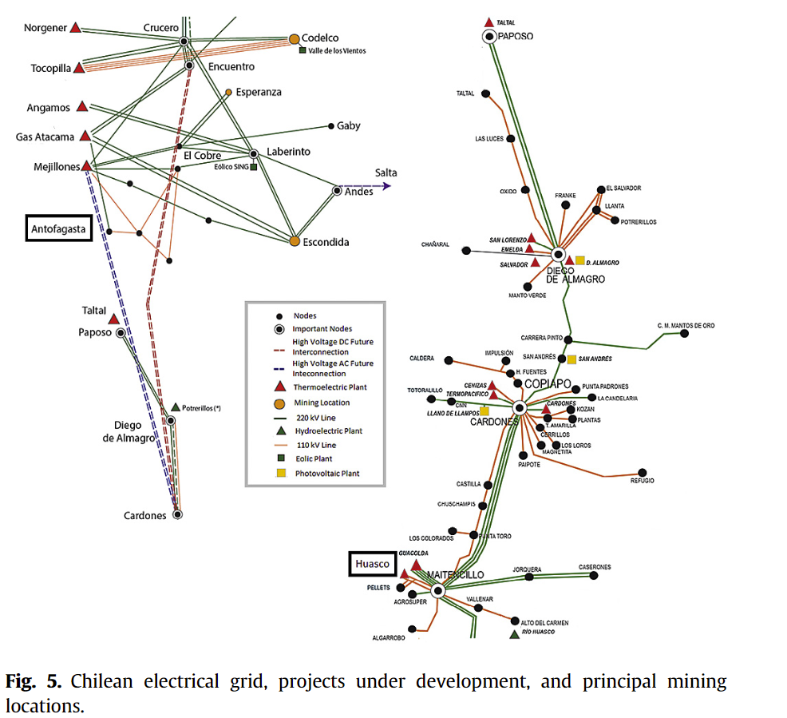
Bound4Blue: Energy Production Determination
Produce now the electricity from the harvested Hydrogen and Oxygen. And electric energy transmission to mining location
Hydrogen combined cycle with 60% efficiency
Each ship provides then 3211 MWh of electrical power.
Power loss for transmission (1500 km) ~ 10%
A global efficiency in the order of 37.8% (wind to electricity) was estimated
A combined-cycle power plant uses both a gas and a steam turbine together to produce up to 50 percent more electricity from the same fuel than a traditional simple-cycle plant.

Slide 15
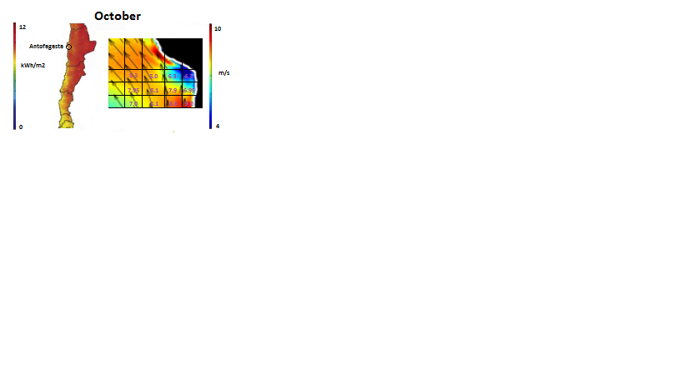
Photovoltaic Panel
Month | Solar Irradiation (kWh/m²Day) | Average Temperature (°C) | Monthly Average Energy Generated (kW/m²)
J | 9.0 | 23.0 | 0.03595
F | 8.5 | 22,5 | 0.03404
M | 7.5 | 22.0 | 0.02991
A | 6,2 | 20.0 | 0.02495
J | 5.0 | 18.0 | 0.02049
J | 4.6 | 17.0 | 0.01894
A | 4.7 | 16.0 | 0.01945
S | 5.5 | 17.0 | 0.02265
O | 6.5 | 17,5 | 0.02670
N | 7.9 | 18.0 | 0.03237
D | 9.1 | 20.0 | 0.03691
η_{A} = availability factor (95%) --- maintenance
η_{F} = derate factor (75%) --- ambient effects
η_{m} = module factor (14,7%) --- module efficiency
Type: polycrystalline, Brand: KOMES, Model: KM(P)24
$$E_{E}=\left(1+α_{C}\left(T_{cell}−T_{amb}\right)\right)η_{A}η_{F}η_{m}I$$

Slide 16
Optimization Problem
An optimization problema was formulated that takes into account:
Cover 10% electrical requirements of the mining industry
Monthly fluctuations of Natural Resources
Increase of the electrical energy requirements of the industry
An objective function equal to the net present value of the proyect evaluated over 10 years.
A learning curve for the production of the vessels
Average Chilean inflation (4.46%)
CAPEX
OPEX
others

Slide 17
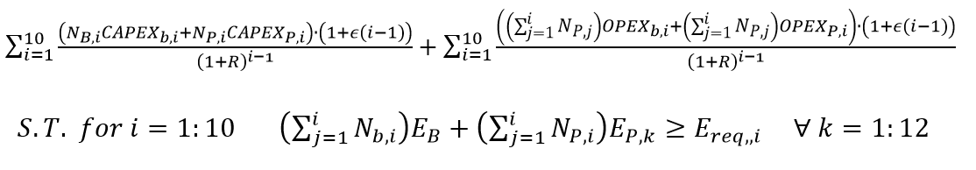
Optimization Problem
N_{B,i} = number of boats to be acquired during the year i
N_{P,i} = number of m² of photovoltaic panels to be acquired during the year i
R = discount rate
∈ = average Chilean inflation (4.46%)

Slide 18
Boat CAPEX
CAPEX PARAMETER | COST (u$/boat)
Boat's hull | 46,130,116
Wingsail system (x8) | 14,882,660
Hydroturbine + transmission | 5,849,145
Power generation equipment & regulation system | 3,647,389
Electrolysis equipment | 7,438,082
H2 and O2 Tanks | 35,720,575
General overrun | 5,983,412
Industrial profit over wingsail system | 892,960
General expenses | 1,934,746
TOTAL CAPEX (u$/boat) | 122,479,083

Slide 19
Solar Panel CAPEX
Solar Panel Components | Price (U$/m²)
Polycrystalline Panel | 131.26
DC/AC converter cost | 16.22
Batteries (U$/m2) for 1/4 of day | 36.98
Land (considering 8 UF/m₂ ; 1 UF = 25937.85 Chilean Pesos) | 296.43
Movable Structure (for 5 modules) | 63.48
Auxiliary costs (10%) (U$/m2) | 24.79
Installation and Construction considering a 20% contingency | 54.55

Slide 20

Year | Boat [Units] | Solar Panels [km²] | CAPEX_{b (MU$)} | CAPEX_{p (MU$)} | OPEX_{b (MU$)} | OPEX_{p (MU$)} | Average Electricity (MW)
1 | 13 | 5,69 | 1556 | 3548,8 | 35,61 | 35,49 | 198,82
2 | 1 | 0,139 | 124,34 | 90,17 | 39,88 | 37,81 | 205,64
3 | 0 | 0,303 | 0 | 203,86 | 41,42 | 41,3 | 214,22
≈ 0.108 U$/KWh …. Lower than regional cost 0,2 U$/KWh

Slide 21

Bound4Blue

Slide 22
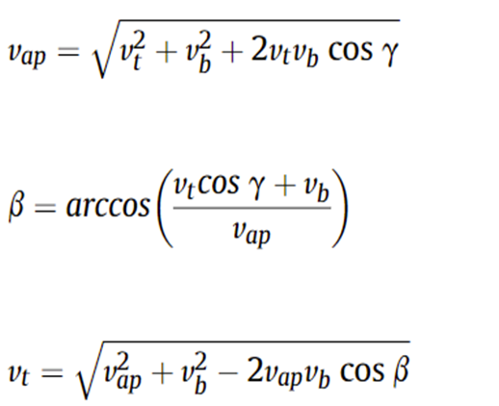
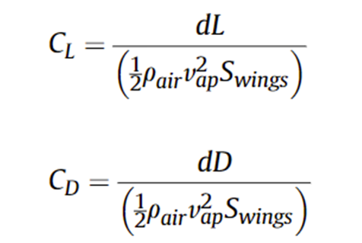
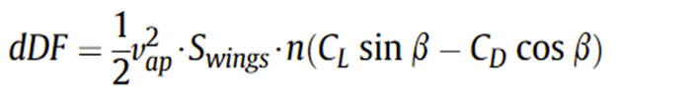
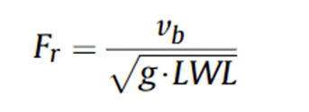
Force Equations

