Slide 1
IEEE International Workshop on Computer Aided Modeling and Design of Communication Links and Networks
OpenCV2X Mode 4: A Simulation Extension for Cellular Vehicular Communication Networks
http://www.cs.ucc.ie/cv2x/
Brian McCarthy and Aisling O’Driscoll
b.mccarthy@cs.ucc.ie and a.odriscoll@cs.ucc.ie
This publication has emanated from research conducted with the financial support of Science Foundation Ireland (SFI) under Grant No: 17/RC-PhD/3479.
Notes:
louder on voice

Slide 2
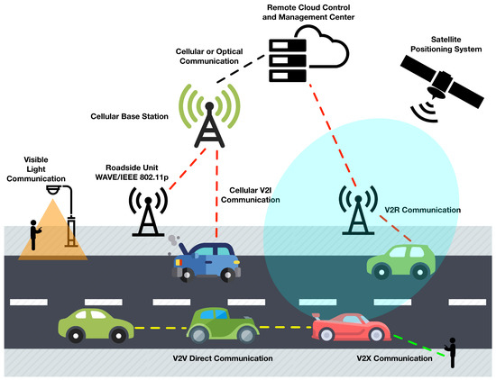
Vehicular Networking 1/4
Vehicular Ad-Hoc Networks (VANETS)
Originating from MANETS (Mobile Ad-Hoc Networks).
Application of Computer networking techniques to vehicles.
Enables inter vehicle communication for services;
Safety Services, vehicle notification about collisions
Cooperative traffic efficiency.
Infotainment. (video streaming)
[1] Arena, F.; Pau, G. An Overview of Vehicular Communications. Future Internet 2019, 11, 27.
Notes:
ITS ->
Too many acronyms.
Important to highlight how do we know it works.

Slide 3
Vehicular Networking 2/4
802.11p Wi-Fi variant (DSRC/WAVE) V2X IT-G5.
OFDM (Orthogonal Frequency Division Multiplexing).
CSMA/CA (Channel Sensing Multiple Access with Collision Avoidance).
Issues around Congestion Control in Dense environments.
Well investigated in academia, trials, commercial equipment and deployments.
C-V2X (Cellular Vehicle to Everything) (LTE-V) Cellular equivalent.
Recently defined by 3GPP release 14.
Release 15 - 5G new radio.
SC-FDMA (Single Carrier – Frequency Division Multiple Access).
SB-SPS (Sensing Based Semi-Persistent Scheduling).
Ready-made infrastructure.
As yet limited investigation.
Notes:
ITS ->
Too many acronyms.
Important to highlight how do we know it works.

Slide 4
Vehicular Networking 3/4
Current regulator vacuums in the US and EU has led to delay in 802.11p deployments.
CV2X Backers
DSRC/WAVE Backers

Slide 5
Vehicular Networking 4/4
Applications and standards:
Cooperative Awareness and ITS applications.
ITS-G5 and WAVE - 802.11p based standards.
Goal:
Enable the vehicular networking community in its investigation of CV2X standard.
Incorporate current day standard application and upper layers with a compliant 3GPP CV2X implementation.
Notes:
ITS ->
Too many acronyms.
Important to highlight how do we know it works.

Slide 6
Current Solutions
Existing C-V2X (Rel 14) simulation models.
Are not publicly available [1].
Concentrate on link layer simulation [2,3].
Do not offer integration with existing Vehicular networking standards such as ITS-G5.
Available across numerous different simulators such as MATLAB. Ns3, OMNeT++.
Capture the system level simulation aspect.
Open Source full stack implementation.
[2] R. Molina-Masegosa and J. Gozalvez, “System level evaluation of lte-v2v mode 4 communications and its distributed scheduling,” IEEE 85th Vehicular Technology Conference (VTC Spring), pp. 1–5, June 2017.
[3] G. Cecchini, A. Bazzi, B. M. Masini, and A. Zanella, “Ltev2vsim: An lte-v2v simulator for the investigation of resource allocation for cooperative awareness,” in 2017 5th IEEE International Conference on Models and Technologies for Intelligent Transportation Systems (MT-ITS), June 2017, pp. 80-85.
[4] D. Wang, R. R. Sattiraju, A. Weinand, and H. D. Schotten, “System-level simulator of LTE sidelink C-V2X communication for 5g,” CoRR, vol. abs/1904.07962, Apr 2019. [Online]. Available: http://arxiv.org/abs/1904.07962
Notes:
- Open Science.
- No concentration on the App layers.
- Not compliant with standards.
- Multiple different platforms makes direct comparison more difficult.
33s

Slide 7
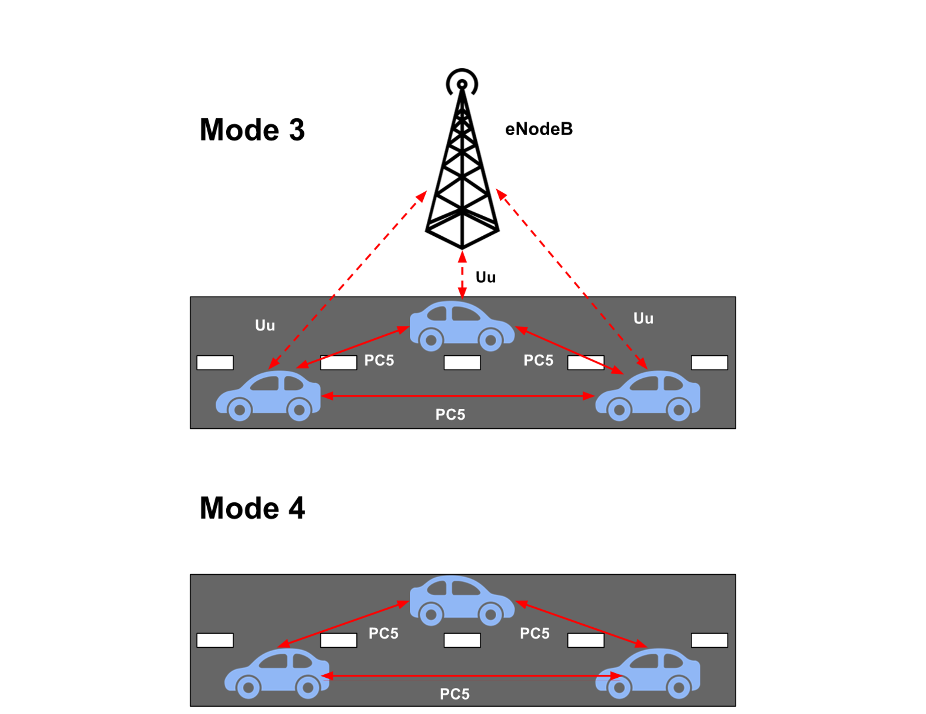
Cellular Vehicle To Everything
Mode 3:
Scheduled
eNodeB Schedules resources for UEs
Mode 4:
Autonomous
UEs select their own resources
Sensing Based Semi-Persistent Scheduling (SB-SPS)

Slide 8
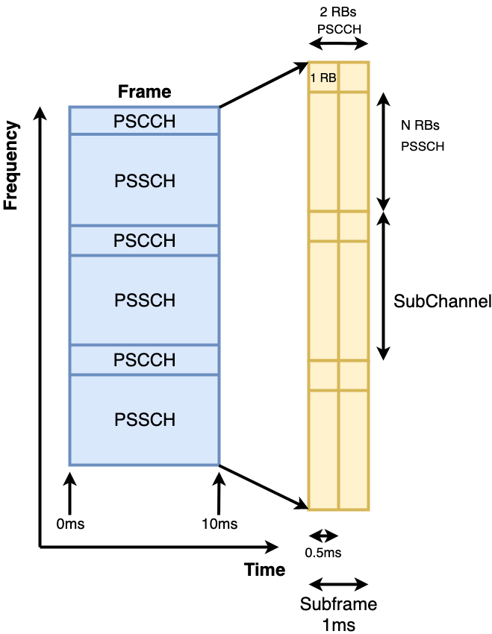
Channelization
Channel broken into subchannels and subframes.
Channel split into PSCCH for sidelink control information (SCI) messages and PSSCH for transport blocks (TBs).
SCI messages act as control for channel.

Slide 9
Selection and Sensing
MAC layer maintains scheduling grant for a certain period, sending at regular intervals in that period. E.g. 100ms
PHY layer selects Candidate Single-Subframe Resources (CSRs).
CSRs are selected based on sensing information (previous SCIs, channel quality measurements).

Slide 10
Transmission
On transmission the MAC layer informs the PHY layer to send an SCI message.
Resource insufficient to support the TB then the reservation is broken and a new reservation is made.
SCI sent in all cases with or without TB.

Slide 11
Implementation
Prevalent Vehicular simulator is OMNeT++
Veins for system level simulation.
Artery [4]:
OMNeT++ for network traffic simulation
Uses SUMO for road traffic simulation
Artery integrates the ITS-G5 standard for the upper layers.
SimuLTE [5]:
Provides an implementation for LTE in OMNeT++
Our bespoke C-V2X Mode 4 implementation builds upon these for Mode 4 simulation.
[5] R. Riebl, H. Gunther, C. Facchi, and L. C. Wolf, “Artery: Extending veins for VANET applications,” in 2015 International Conference on Models and Technologies for Intelligent Transportation Systems (MT-ITS), Budapest, Hungary, June 3-5, 2015, 2015, pp. 450–456. [Online]. Available: https://doi.org/10.1109/MTITS.2015.7223293
[6] A. Virdis, G. Stea, and G. Nardini, “Simulating lte/lte-advanced networks with simulte,” in Simulation and Modeling Methodologies, Technologies and Applications, M. S. Obaidat, T. ̈Oren, J. Kacprzyk,and J. Filipe, Eds. Cham: Springer International Publishing, Jan 2016, pp. 83–105.
[7] Study on LTE-based V2X services (v14.0.0, Release 14), 3GPP, July 2016, 3GPP TR 36.885.
Notes:
Highlight the bespoke implementation.
The integration of

Slide 12
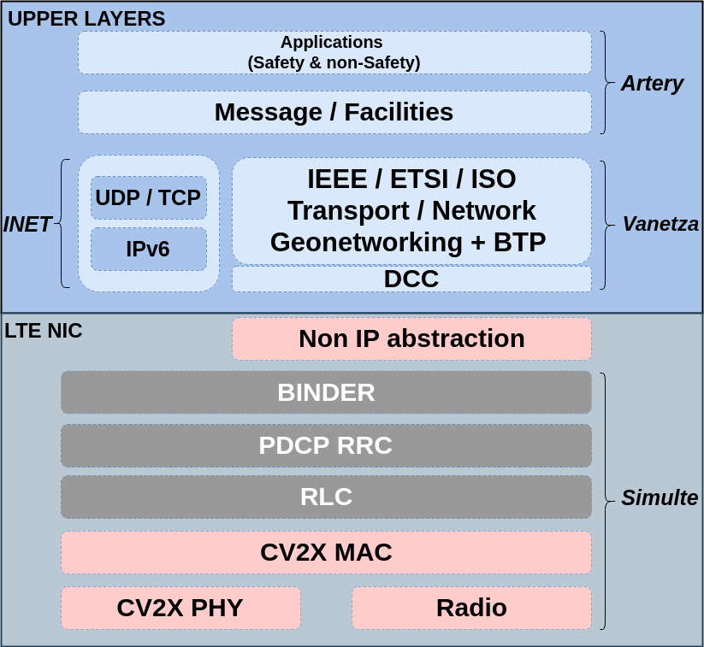
Implementation: Overview of architecture
Notes:
Artery SUMO and apps, message layers
Vanetza ITS-G5 implementation.
Red is new layers of the stack.
Grey is adapted for Non-IP traffic.
SimuLTE IPV4 Artery IPV6
Pinky red.
Change the bottom one to white and it’s more obvious, change up the colours. Make it more obvious

Slide 13
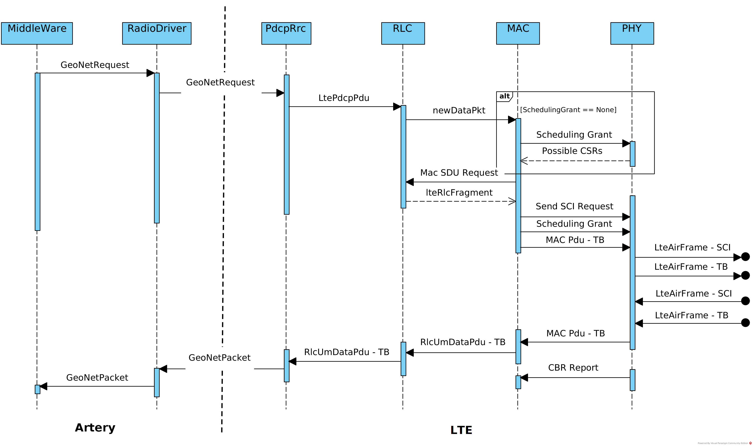
Implementation: Message Sequence Diagram.
Notes:
Explain Scheduling with this.
CSR selection.
1:37
Animating + lazer pointer
Relate to what impact it makes on the performance.
Relate to real life.

Slide 14
Scenario Description
Highway Fast:
200 vehicles at most dense at 140 km/h
Highway Slow:
380 vehicles at most dense at 70 km/h
Network Configuration
Winner+ B1 LOS | 16 RBs per subchannel
Nakagami Fading | MCS 5 & 7
10 MHz Bandwidth (48 RBs) | Tx Rate 10 Hz
23 dBm transmission Power | 190 Byte + 300 Byte packets
3 Subchannels
SB-SPS parameters:
ProbResourceKeep
Sensing Window Length
Packet loss causes
2 Vehicular Scenarios
Statistic:
Packet Delivery Rate
[8] Study on LTE-based V2X services (v14.0.0, Release 14), 3GPP, July 2016, 3GPP TR 36.885.
Notes:
1:13s
Put it all in the table. Mobility pattern, highway fast + slow and describe.
Highlight vehicle count, BOLD
Better explanation of the scenarios.
What does that mean when PDR less than 80%.
Contribution, the results examples of what you can do with it.
What do people know about CV2X
LTE vs 802.11p
Number of simulations for each and get them all at the same level.
Highlight that this is from the standard

Slide 15
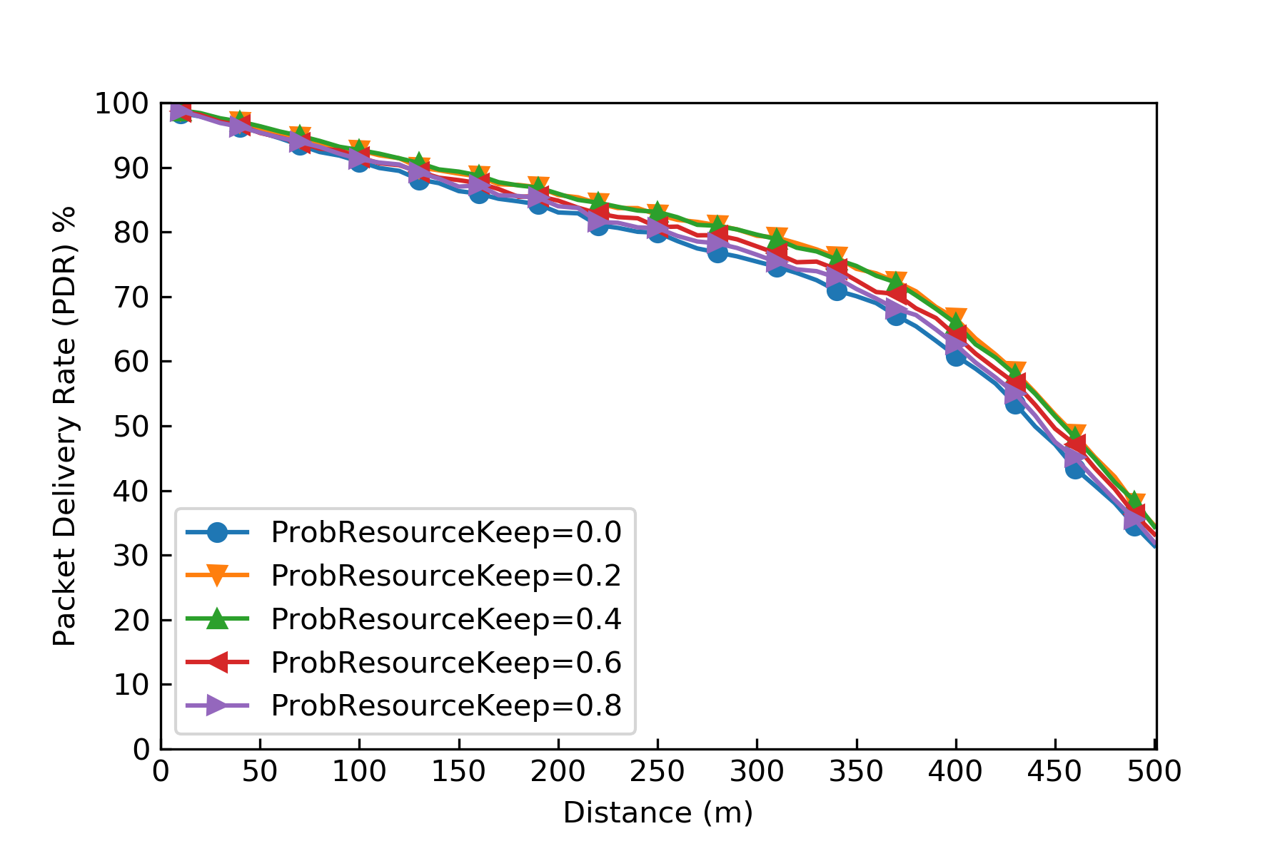
Results 1/4
ProbResourceKeep
Controls the likelihood of maintaining a grant once allocated.
Higher probability means greater likelihood of losing grant
Notes:
1:24s
Break into two slides to show it more easily. Increased size.
Colours are the same for the best results.
Say Fast.
Look at slow for ProbResourceKeep more interesting.
What's the ratio of the received from one individual. Might be more interesting.
Spoof attacks and their impact.

Slide 16
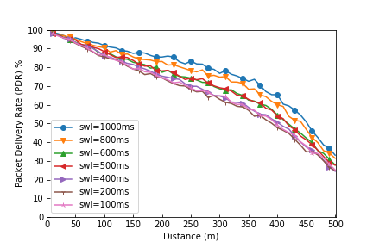
Results 2/4
Sensing Window Length (swl)
History of SCIs and RSRP/RSSI measurements maintained.
Notes:
1:24s
Break into two slides to show it more easily. Increased size.
Colours are the same for the best results.
Quality

Slide 17
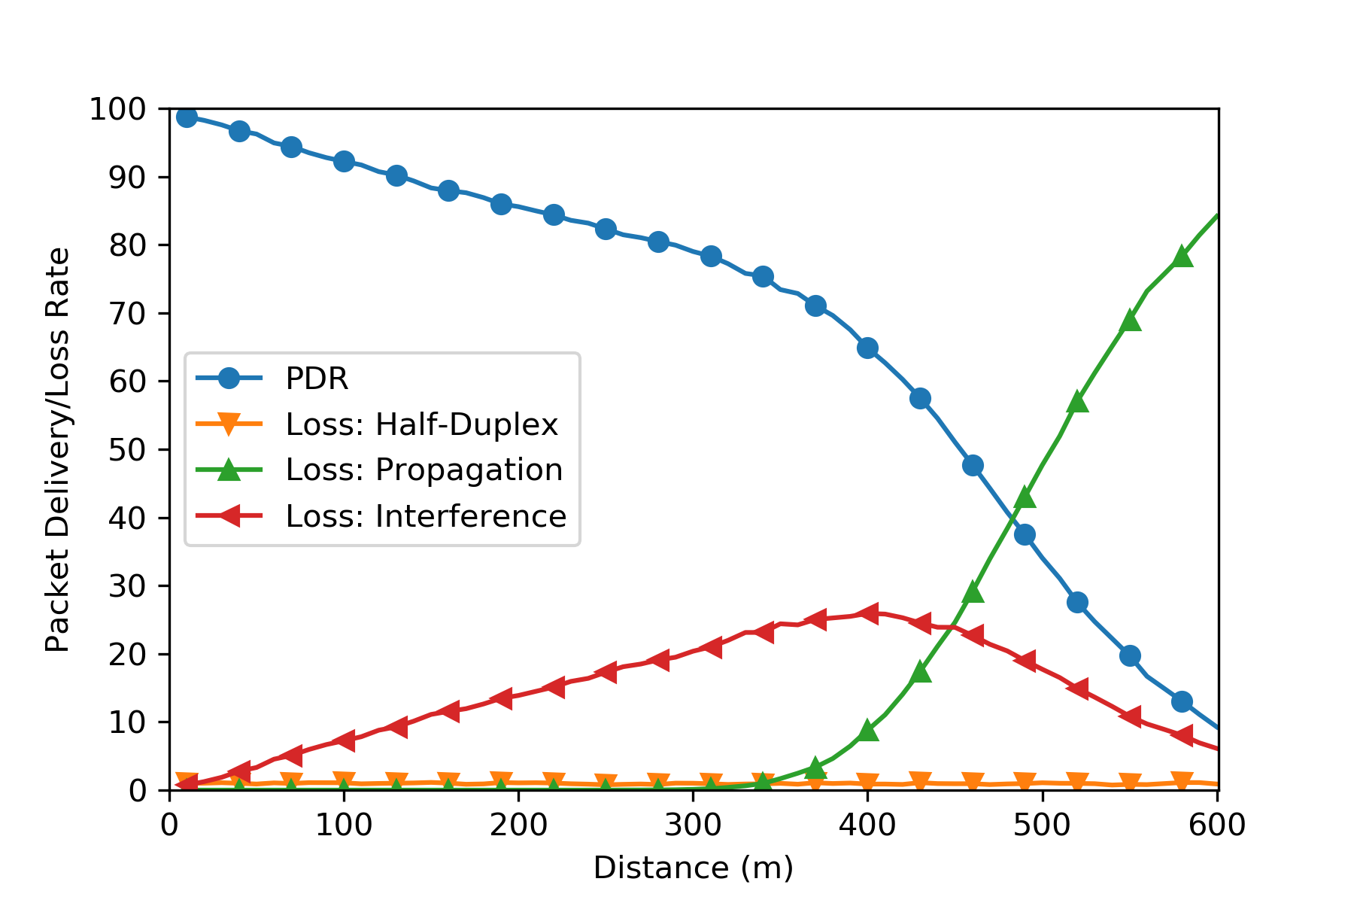
Results 3/4
Packet loss causes
Initially primary cause is Interference from others
As distance increases propagation loss become the primary factor in packet loss
Notes:
47s
2 Slides.
Make a point on the point when propogation goes past interference

Slide 18
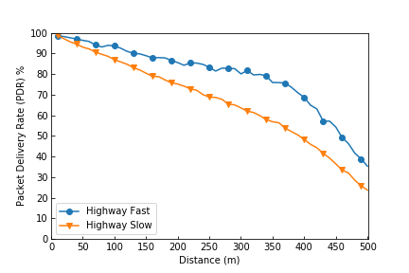
Results 4/4
Comparison of Fast and Slow
As shown congestion has a significant impact on performance of CV2X
Notes:
47s
2 Slides.
Make a point on the point when propogation goes past interference
Quality

Slide 19
Future Work
Thorough analysis of CV2X simulation parameters.
RSRP thresholds.
RSSI threshold for CBR.
CV2X Mode 4 performance for Non-periodic traffic.
Current periodic beaconing.
Constant breaking of reservations leading to inefficient use of resources.
Congestion control mechanisms
Decentralised Congestion Control (DCC).
3GPP specified mechanisms.
Absence of work, as it's SB-SPS is a competitive access mechanism.
Notes:
Non-Periodic:
SB-SPS "Semi-Persistent" bad if not persistent
Congestion Control:
Obviously not going to fix all issues, mechanisms will need to be looked at.
Mode 3:
Good for ITS applications such as traffic management, any distance comm between vehicles.
1:40

Slide 20
Our Contribution
A freely available, open-source implementation of the 3GPP Release 14 C-V2X Mode 4 standard.
With the inclusion of the current ITS-G5 will enable a more robust investigation of the CV2X standard.

Slide 21
Thank you for your time.
The model is available here
http://www.cs.ucc.ie/cv2x/
&
GitHub
https://github.com/brianmc95/OpenCV2X
Please feel free to contact me:
Brian McCarthy – University College Cork
b.mccarthy@cs.ucc.ie
Notes:
Software release date.
Generic
Put email there instead.

