Slide 1
Optimal (R, s, S) policy for the inventory lot sizing problem with stochastic non-stationary demand
IWLS – 22nd August, Paris
Andrea Visentin, Steven Prestwich, Roberto Rossi, Armagan Tarim

Slide 2
Roadmap
Introduction
Baseline
Method
  Memoization
  Branch and bound
Experimental results
Conclusion

Slide 3
Introduction

Slide 4
Inventory control policy
Manage the inventory level with a supplier/producer and demands to satisfy.
An inventory control policy defines:
When to place an order
Order quantity

Slide 5
Inventory Control

Slide 6
Inventory Control
Orders

Slide 7
Our configuration
An inventory control policy define:
Single item
Single location
Stochastic non stationary demand
Complete backordering of excessive demand

Slide 8
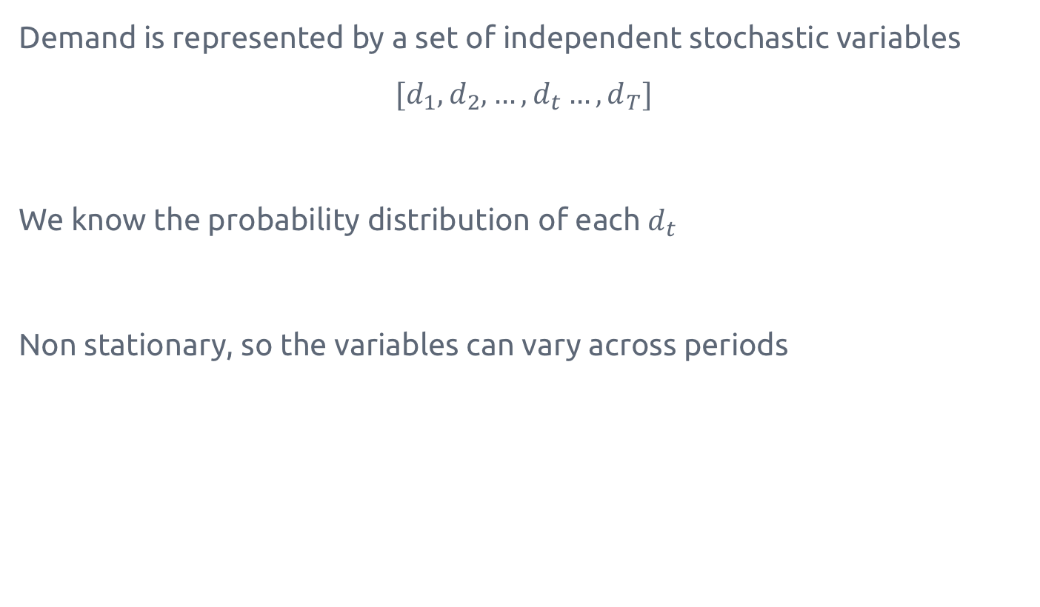
Demand
Demand is represented by a set of independent stochastic variables
$$[d_{1},d_{2},…,d_{t}…,d_{T}]$$
We know the probability distribution of each $d_{t}$
Non stationary, so the variables can vary across periods

Slide 9
Non stationary

Slide 10
Demand backorders
Demand backlogging

Slide 11
Costs
The objective is to minimize the expected cost of the policy.
K - fixed ordering cost
h - linear holding cost (per unit per period)
p - linear penalty cost (per unit per period)
W - fixed review cost

Slide 12
Policies
Policies with flexible order quantity:
(s, S)
(R, S)
(R, s, S)

Slide 13
(s, S)
S₃
S₁
S₀
s₁
s₃
s₀

Slide 14
(s, S)
Scarf, 1958 proved the optimality of the (s,S) policy with complete backlogging and penalty cost.
It can be solved to optimality with Stochastic Dynamic Programming.

Slide 15
(R, S)
S₁
S₀
R₁
R₂
R₃

Slide 16
(R, s, S)
S₁
S₀
s₁
s₂
s₃
R₁
R₂
R₃
R₄

Slide 17
(R, s, S)
S₁
S₀
s₁
s₂
s₃
R₀
R₁
R₂
R₃

Slide 18
(R, s, S)
S₁
S₀
s₁
s₂
s₃
R₁
R₂
R₃

Slide 19
(R, s, S)
According to Silver et al, 1981 is one of the most frequently met inventory control methods. Even if the determination of the exact best values of the three parameters is extremely difficult.
No optimal solution for the (R, s, S) problem is present in the literature

Slide 20
Baseline

Slide 21

Stochastic Dynamic Program for (s, S)
For each period t, $I_{t}$ is the closing inventory level and $Q_{t}$ is the size of the order place in that period.
$C_{t}(I_{t−1})$ is the expected cost of the optimal policy over periods ${t, …, n }_{ }$ starting with inventory $I_{t−1}$.

Slide 22



Stochastic Dynamic Program for (s, S)
$$C_{8}(60)$$
$$C_{5}(20)$$
$$C_{3}(10)$$

Slide 23
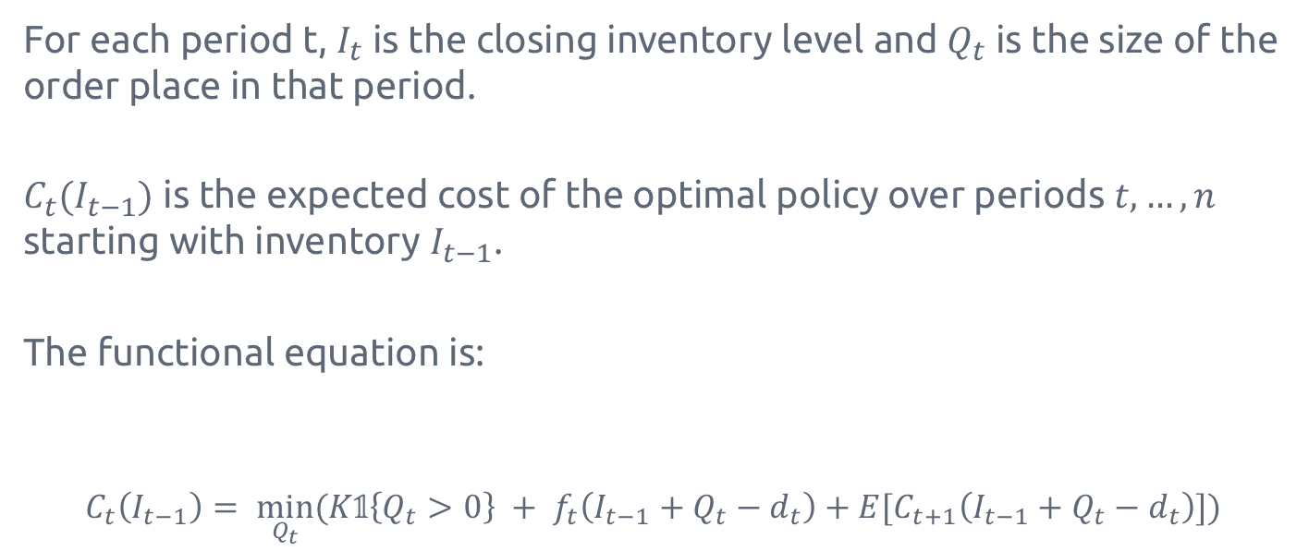
Stochastic Dynamic Program for (s, S)
For each period t, $I_{t}$ is the closing inventory level and $Q_{t}$ is the size of the order place in that period.
$C_{t}(I_{t−1})$ is the expected cost of the optimal policy over periods ${t, …, n }_{ }$ starting with inventory $I_{t−1}$.
The functional equation is:
$$C_{t}\left(I_{t−1}\right)= \min_{Q_{t}}{(K𝟙\left\{Q_{t}>0\right\} + f_{t}\left(I_{t−1}+Q_{t}−d_{t}\right)+E[C_{t+1}\left(I_{t−1}+Q_{t}−d_{t}\right)])}$$
Order cost
Expected cost of future periods
Order quantity
Holding/penalty cost

Slide 24

Stochastic Dynamic Program for (s, S)
The base case is:
$$C_{n+1}\left(∗\right)=0$$
And the optimal cost of a policy is:
$$C_{1}\left(I_{0}\right)$$
Where $I_{0}$ is the initial inventory.

Slide 25
Baseline
If the review periods are fixed, the problem is reduced to (s, S).
We can compute optimal (s, S) policies for all the possible review periods. The one with the minimum cost among them is the optimal (R, s, S) policy.

Slide 26
Reduction to (s, S)
S₁
S₀
s₁
s₂
s₃
R₂
R₀=1
R₃=1
R₅=1
R₈=1
R₁=0
R₂=0
R₄=0
R₆=0
R₇=0
R₉=0
R₁₀=0

Slide 27
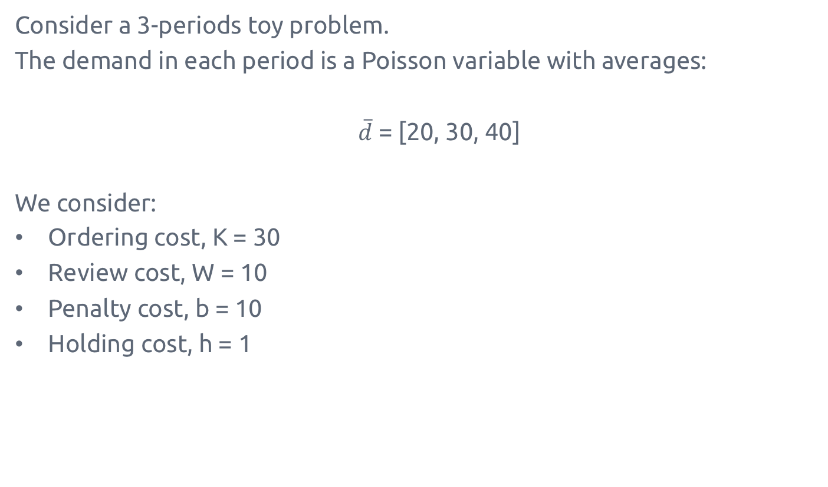
Example
Consider a 3-periods toy problem.
The demand in each period is a Poisson variable with averages:
$\overline{d}$ = [20, 30, 40]
We consider:
Ordering cost, K = 30
Review cost, W = 10
Penalty cost, b = 10
Holding cost, h = 1

Slide 28
Example
R₁ | R₂ | R₃ | Expected cost
0 | 0 | 0 | 1600
0 | 0 | 1 | 751
0 | 1 | 0 | 304
0 | 1 | 1 | 302
1 | 0 | 0 | 185
1 | 0 | 1 | 143
1 | 1 | 0 | 153
1 | 1 | 1 | 150

Slide 29
Memoization

Slide 30
Idea
The baseline repeats multiple times the same computations
Restructure the previous problem into a tree

Slide 31

Stochastic Dynamic Program for (s, S)
$$C_{5}(7)$$
R₀=?
R₁=?
R₂=?
R₃=?
R₄=?
R₅=1
R₈=1
R₆=0
R₇=0
R₉=0
R₁₀=0

Slide 32
Example
R₁ | R₂ | R₃ | Expected cost
0 | 0 | 0 | 1600
0 | 0 | 1 | 751
0 | 1 | 0 | 304
0 | 1 | 1 | 302
1 | 0 | 0 | 185
1 | 0 | 1 | 143
1 | 1 | 0 | 153
1 | 1 | 1 | 150

Slide 33
C₄
C₄
C₄
C₄
R₃=0
R₃=0
R₃=1
R₃=1
C₃
C₃
C₃
C₃
R₂=0
R₂=0
R₂=1
R₂=1
C₂
C₂
C₂
C₂
R₁=0
R₁=1
R₁=0
R₁=1
C₁
C₁
C₁
C₁

Slide 34
C₄
R₃=1
R₃=0
C₃
C₃
R₂=1
R₂=0
R₂=1
R₂=0
C₂
C₂
C₂
C₂
R₁=1
R₁=0
R₁=1
R₁=0
R₁=1
R₁=0
R₁=1
R₁=0
C₁
C₁
C₁
C₁
C₁
C₁
C₁
C₁

Slide 35
n+1
R₃=1
R₃=0
n
n
R₂=1
R₂=0
R₂=1
R₂=0
n-1
n-1
n-1
n-1
R₁=1
R₁=0
R₁=1
R₁=0
R₁=1
R₁=0
R₁=1
R₁=0
n-2
n-2
n-2
n-2
n-2
n-2
n-2
n-2

Slide 36
0
R₃=1
R₃=0
22
11
R₂=1
R₂=0
R₂=1
R₂=0
72
62
74
64
R₁=1
R₁=0
R₁=1
R₁=0
R₁=1
R₁=0
R₁=1
R₁=0
150
302
143
752
153
305
185
1600

Slide 37
Computational analysis
The baseline is computing 2^{n} n nodes, 24 in our example.
While the tree solution uses only 2^{n+1}, 14 in our example
There is an improvement of an n/2 factor.

Slide 38
Branch and bound

Slide 39
Branch and bound
The tree structure allows the deployment of B&B techniques.
If we can prove that a subtree does not contain any improvement, we can prune it without compromising the optimality.
Each node has a minimum value associated higher than the ancestors.
If the minimum of a node is higher than the best solution so far, the subtree can be pruned.

Slide 40
0
22
11
72
62
74
64
150
302
143
752
153
305
185
1600

Slide 41

Pruning condition
If
$$\min_{I}{(C_{t}^{a}(I))}≥V_{bsf}$$
Where $V_{bsf}$ is the cost of the best policy computed so far, we can prune the tree without compromising the optimality.

Slide 42
0
22
11
72
62
74
64
?
150
302
143
752
153
305
185
1600

Slide 43
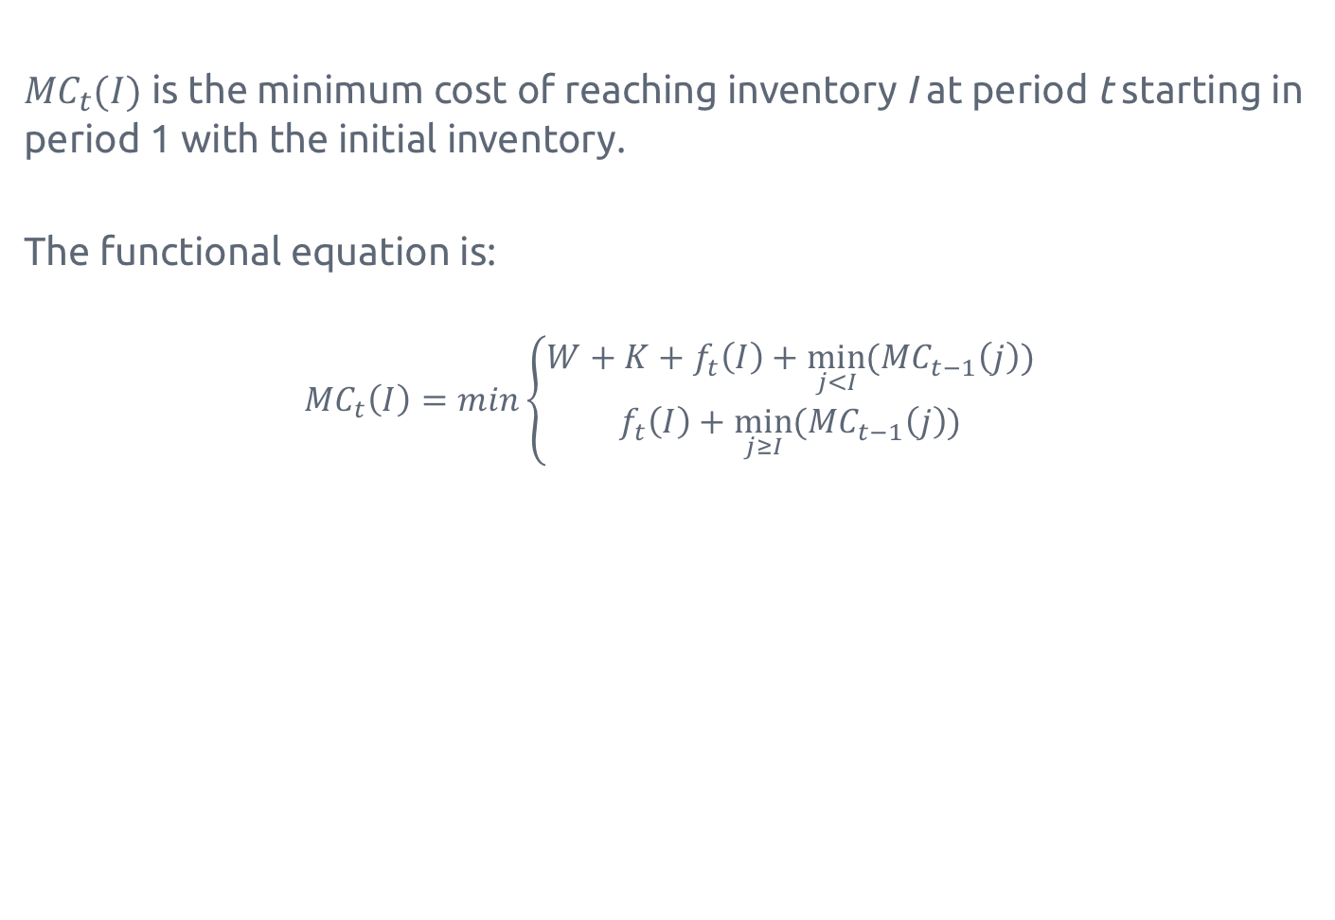
Dynamic Programming lower bounds
${MC}_{t}(I)$ is the minimum cost of reaching inventory I at period t starting in period 1 with the initial inventory.
The functional equation is:
$${MC}_{t}\left(I\right)=min\left\{\begin{matrix}W+K+f_{t}\left(I\right)+\min_{j<I}({MC}_{t−1}\left(j\right)) \\ f_{t}\left(I\right)+\min_{j≥I}({MC}_{t−1}\left(j\right))\end{matrix}\right.$$
Placing an order
Not placing it
Notes:
$${MC}_{t}\left(I_{t}\right)$$

Slide 44

Pruning condition - updated
If
$$\min_{I}{(C_{t}^{a}\left(I\right)+{MC}_{t}(I))}≥V_{bsf}$$
we can prune the tree without compromising the optimality.

Slide 45
0
107
109
142
138
144
181
150
302
143
752
-
-
-
-

Slide 46
Computational results

Slide 47
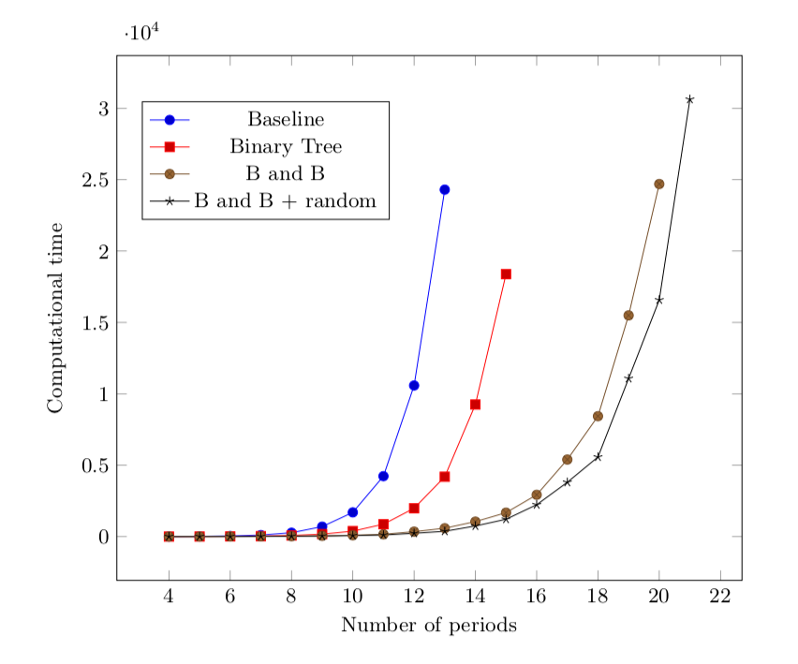
Computational time

Slide 48
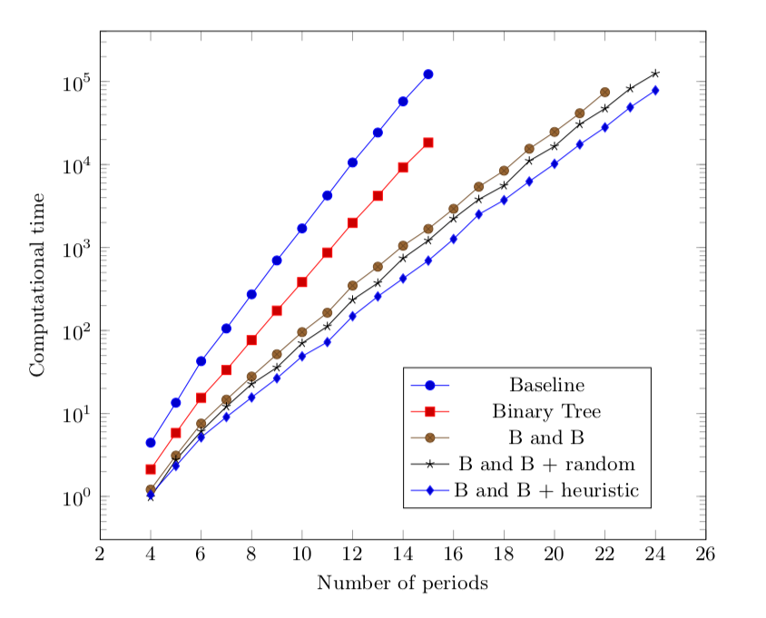
Computational time log

Slide 49
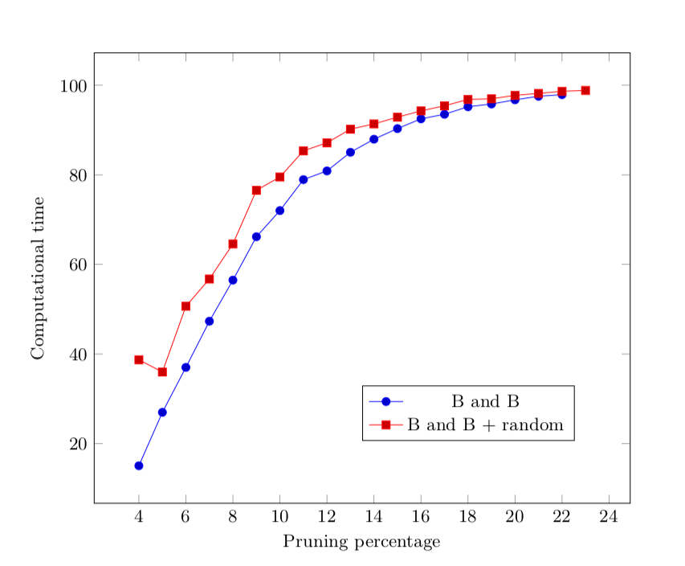
Pruning percentage

Slide 50
Conclusion

Slide 51
Conclusion
(R, s, S) is a widely used inventory control method.
We introduced a new technique that solves the problem to optimality.
It can solve instances twice as big as the baseline.
Future work:
A pure SDP formulation for (R, s, S)
Heuristics for (R, s, S)
Notes:
$${MC}_{t}\left(I_{t}\right)$$

Slide 52
Thanks for the attention
Questions?

