Slide 1
Smartphone-based Activity Recognition for Pervasive Healthcare - Utilizing Cloud Infrastructure for Data Modeling
Bingchuan Yuan, John Herbert
University College Cork, Ireland

Slide 2
Outline
1
Introduction
2
Activity Recognition Approach
3
Cloud-based Data Modeling
4
Experiment & Result
5
Conclusion

Slide 3
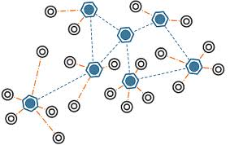
Introduction
Pervasive Healthcare
Traditional clinical setting → Home-centered setting
Wireless Sensor Networks (WSNs)
&Communication technologies
Internet
WSN
Notes:
The phenomenon of an aging society has a direct impact in healthcare systems(shortage of medical resources, rising healthcare costs and reduction of quality in healthcare services). Pervasive healthcare has emerged as a technology-driven approach to reduce long-term healthcare expenses and improve quality of healthcare services.
Pervasive healthcare enables healthcare to move from hospital-centered setting to self-care, mobile care, and at-home care by utilizing wireless sensor networks and communication technologies.

Slide 4
Introduction
CARA for Pervasive Healthcare
CARA (Context-Aware Real-time Assistant)
Real-time
Intelligent
At-home healthcare
Activity Recognition in CARA
Activity of Daily Living (ADL) monitoring
Anomaly detection
Notes:
The CARA system is design to provide a real-time intelligent at-home pervasive healthcare solution for independent living. To achieve that the system should be able to observe, interpret and reason the dynamic contexts in a smart home environment.
ADL is a primary indicator of quality of life and it is a vital context for pervasive healthcare system. It is important for the CARA system to have a mechanism to accurately recognize and continuously monitor activities of daily living (ADL).
Activity recognition can also be used in conjunction with pattern recognition to detect changes in a subject’s routine, and further to support the CARA reasoning framework for anomaly detection.

Slide 5
Introduction
State of The Art
- Environmental sensor-based approach
Pros: ambient assistant monitoring
Cons: intrusive, large installation
- Wearable sensor-based approach
Pros: small, low cost, non-invasive
Cons: customized, impractical, processing power
- Smartphone-based approach
Pros: ubiquity, sensing and computing
Cons: battery, insufficient accuracy
Notes:
Three approaches for activity recognition have been extensively studied using different underlying sensing mechanisms.
The first method relies upon environmental sensors (e.g. smart home sensors, cameras) to track aspects such as motion, location and object interaction. It is a promising approach for recognizing activities which cannot be simply distinguished by body movement alone. However, it usually requires installation of a lot of sensors, and these sensors are often intrusive. In some cases it is only feasible for use in laboratory settings.
Another approach uses a Body Area Network (BAN) to track the acceleration of the body. The BAN usually consists of multiple wearable wireless sensors which are small in size, lightweight, low cost and non-invasive. However, most of the sensors are customized which makes them hard to be integrated into other systems. And it is sometime inconvenient to wear these sensors and impractical for continuous long term monitoring. Less processing power, need additional computing node.
While the ubiquity of smartphones and their capability of sensing, processing and communications make them an alternative platform to wearable sensors. However, the battery of the smartphone is always an issue and it is insufficient to track the body movement using just a single smartphone which makes the performance less effective.

Slide 6
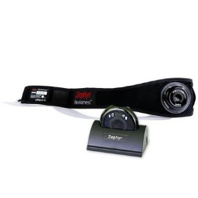
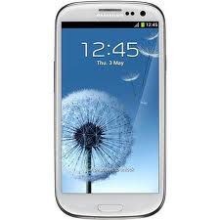
Activity Recognition
Our Approach
Smartphone-based
Wearable wireless sensor integrated
Hybrid Classifier
Cloud-based data modeling
Notes:
In this work, we provide a smartphone-based and wearable wireless sensor integrated solution for the unobtrusive detection of activity.
The data were collected using an Android smartphone and the Zephyr BioHarness sensor. The embedded accelerometer and gyroscope sensors measure the acceleration and orientation of the body.
A hybrid classifier is developed by combining threshold-based methods and machine learning technologies.
A cloud-based data analysis component is designed to build classification models using different machine learning algorithms and to select the most suitable model for each user so that the classification model becomes adaptive to different user. It also overcomes the limitation of the computing power and save the battery life of the smartphone.

Slide 7
Activity Recognition
ADLs in a Home Environment
- Static Posture:
Sitting, Standing, Lying, Bending and Leaning back
- Dynamic Movement:
Walking, Running, Walking Stairs, Washing Hands, Sweeping and Falling
Notes:
The basic activity of daily living in a home environment can be divided into two categories: static posture and dynamic movement. Static posture indicates the position of the body which consists of Sitting, Standing, Lying, Bending and Leaning back, whereas dynamic movement involves a series of multiple actions. The dynamic activities we considered in our work include: Walking, Running, Walking Stairs, Washing Hands, Sweeping and Falling.

Slide 8
Activity Recognition
Overview
Load Classification Model
Data Collection
Feature Extraction
Distinguish Static and Dynamic Activity
Activity Classification
Classification Model Optimization
Notes:
Here is the overview of the work flow of proposed activity recognition approach.
1. The machine learning classification model is loaded from the cloud into the smartphone.
2. Raw data are collected from BioHarness sensor and build-in smartphone sensors.
3. The signals are segmented by a time window. Features corresponding to each window are extracted.
4. Threshold value of the acceleration is applied to distinguish static and dynamic activity.
5. Static activities are identified using threshold-based method. Dynamic activities are classified using machine learning classifiers with the classification model.
6. Features and activity recognition result are stored in the data file which can be uploaded into the cloud to retrain the classifier and refine the classification model.

Slide 9
Activity Recognition
Feature Extraction
1s - Window
Washing Hand
Walking
Running
Sweeping
Notes:
It is essential to extract features from the raw sensor data in order to improve the quality and reduce the quantity of sensor readings. This is typically performed by breaking the continuous data into windows of certain duration.
In this work, we experimented with one second window which is overlapped by one half of the window length. Hence, each window is a single instance, but any given data point contributes to two instances.

Slide 10
Activity Recognition
Feature Extraction
Feature | Trunk Acceleration | Thigh Acceleration | Thigh Orientation
Min | X, Y, Z, |ACC| | X, Y, Z, |ACC| | Azimuth, Pitch, Roll, |GYRO|
Max | X, Y, Z, |ACC| | X, Y, Z, |ACC| | Azimuth, Pitch, Roll, |GYRO|
Mean | X, Y, Z, |ACC| | X, Y, Z, |ACC| | Azimuth, Pitch, Roll, |GYRO|
Standard Deviation | X, Y, Z, |ACC| | X, Y, Z, |ACC| | Azimuth, Pitch, Roll, |GYRO|
Zero Cross | X, Y, Z | X, Y, Z | Azimuth, Pitch, Roll
Mean Cross | |ACC| | |ACC| | |GYRO|
Angular | X, Y, Z | X, Y, Z
Notes:
This table summarizes features extracted from each window. Each window is represented as a feature vector of length 66.

Slide 11
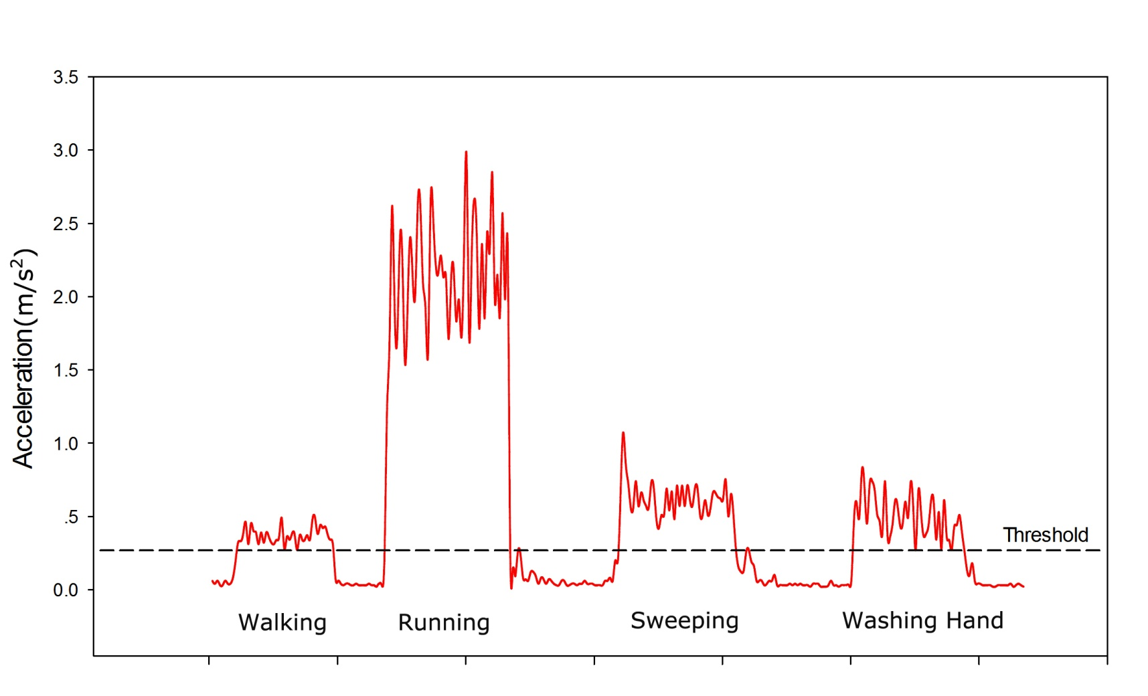
Activity Recognition
Distinguish static and dynamic Activity
Dynamic Activity
Static Activity
Notes:
To distinguish static and dynamic activity, we explored features extracted from segmented sensor readings and it turns out the standard deviation is the most useful metric. We apply thresholds to the standard deviation of both smartphone and BioHarness accelerometer signals. This graph gives an example of the threshold for trunkl acceleration.
The threshold for trunk acceleration was set at 0.25 m/s2 and the threshold for thigh acceleration was set to 0.2 m/s2 to ensure that all motionless activities are detected.

Slide 12
Activity Recognition
Real-time Activity Classification Using Hybrid Classifier
- Static activity:
Threshold-based method
- Dynamic activity:
Machine learning classification model
Notes:
Static activity can be successfully recognized by using a threshold based method. We use two accelerometers, one mounted on the trunk and another mounted on the thigh to detect the posture of upper and lower body.
Dynamic activity can be recognized by identifying patterns of people's movement through machine learning classifiers with trained classification model.

Slide 13
Activity Recognition
Static Activity
Inclination Angle:
Notes:
For static activity, the mean acceleration over the one second window is converted to a corresponding inclination angle using this equation. The figure outlines the upper and lower threshold values for determining the trunk position. Similarly, thresholds are applied to the thigh acceleration. Static activity is classified according to the position of trunk and thigh.

Slide 14
Activity Recognition
Dynamic Activity
Weka* for data mining
Machine learning algorithms:
- Bayesian Network
- Decision Tree
- K-Nearest Neighbor
- Neural Network
* Weka 3: Data Mining Software (Developed by University of Waikato)
Notes:
For dynamic activity, the open source Weka machine learning package is used in this study to develop the machine learning mechanism. This package provides a collection of machine learning algorithms for data mining. In this work, four popular machine learning algorithms are investigated and evaluated. The machine learning classifier obtains a model during the training stage. After training, it can classify the dynamic activity for new instances using the classification model.

Slide 15
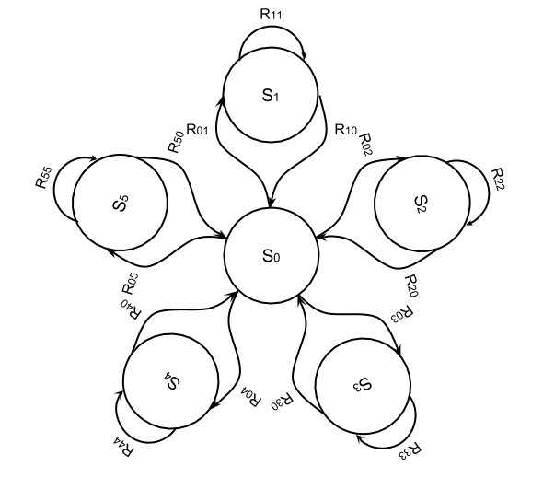
Activity Recognition
Transition of Activity States
S₀: Transitional State
S₁-S₅: State of each activity
R: Transition Rule
Notes:
It is easy for the machine learning classifier to misclassify the activity when the movement of a subject is changing (e.g. walk to run). So we introduce a Transitional State to fill the gap between activities. Basic rules are specified that if the classified activity state is different from the previous activity state, it should go to the transitional state rather than change to the new activity state directly. In fact, this method could improve the recognition rate by getting rid of some misclassified activity data.

Slide 16
Cloud-based Data Modeling
Activity Data Modeling
Training the classification models: tradeoff between accuracy and cost
- Personalized model:
One for each individual (better accuracy)
- Universal model:
One size fits all (lower cost)
Notes:
To build classification model for machine learning classifier, activity data are collected from users and labeled for supervised learning.
The classification model built on the data of each individual is referred to as the Personalized Model. Although the Personalized Model is able to provide a better result for a specific user, it may be not reliable or suitable for other users.
A more generalized model is demanded to fit with all the users. Hence, data collected from all the subjects are pooled together to build a universal model. We use it as the default model for each new user.
However, the universal model may not exactly fit each individual because of physical differences between individuals. In addition, the supervised learning scheme requires a great effort of manually labeling the activity data. As a result, we study the adaptation of a classification model and develop the cloud-based data modeling framework.

Slide 17
Cloud-based Data Modeling
Model Adaptation
Notes:
The principle of model adaptation is to keep updating the classification model for an individual user. All the new users start with a default classification model, which in turn gets refined and adapted to each individual user for better performance when more activity data are available as users carry the phone.
On the client side, real-time activity recognition is carried out in the smartphone using the classification model. An unsupervised learning scheme is applied to generate new training data. It reuses the predicted label and confidence value generated by the machine learning classifier during the inference process to select new training samples. The adaptation method determines whether a data sample is suitable for adaptation according to the confidence level of the inference result and uses high confidence samples. The new training data are recorded in the smartphone and are uploaded to the cloud server periodically.

Slide 18
Cloud-based Data Modeling
Cloud-based Data Analysis Framework
Notes:
On the cloud side, multiple worker roles are deployed for analyzing user’s activity data and producing the best classification model for the user. Controller Node, Machine Learning Nodes (including a Universal Modeling Node) and Evaluation Node.
Process: Once new training data is uploaded by the client. The URL of the training data is collected by the Controller Node and assigned as different tasks to machine learning worker roles. The data are then used to either build new classification model in the case of a new user or refine the existing model. Moreover, the data are also fused with the previous data of all users to update the Default Model in the Universal Node. In the experiment, four machine learning worker roles work in parallel to process data analysis tasks. Each of the worker roles is designed to handle one popular machine learning algorithm. However, the number of worker roles is able to be adjusted on demand which makes use of the flexibility and scalability of the cloud infrastructure. The models are generated and evaluated for each machine learning classifier in worker roles. After gathering the evaluation results of all the models in the evaluation node, the most suitable model is selected according to the performance of each model. The data (combining new training data and any previously existing data) of that user are then filtered by a misclassified filter using the best model and stored in the cloud storage as previous data. Once the process is finished, the best model is sent back to the user automatically. Thus, the new classification model can be used in the mobile client for real-time classification.

Slide 19
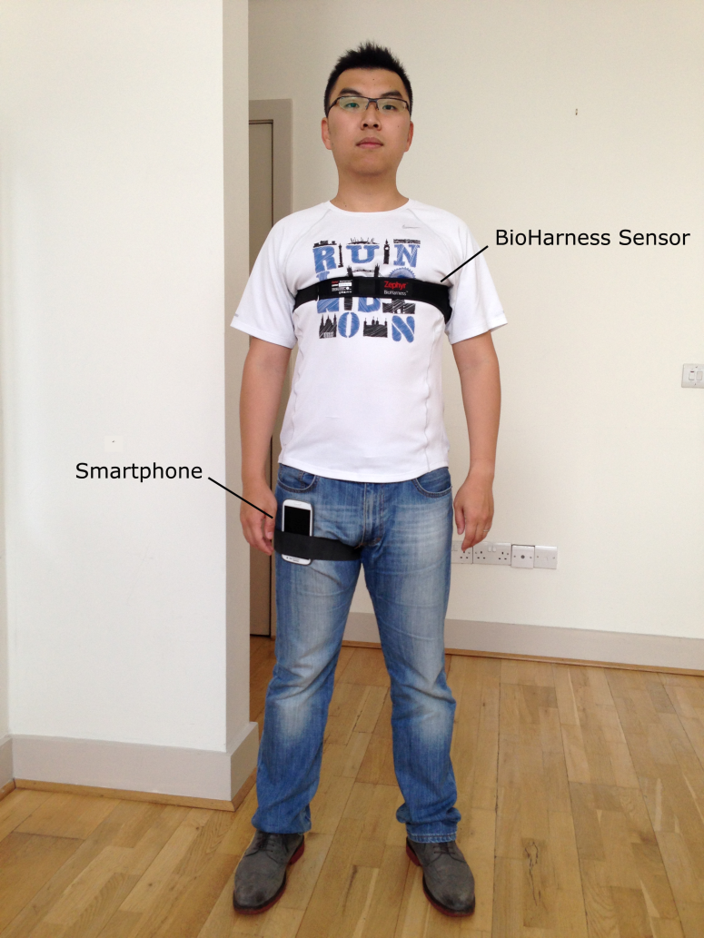
Experiment and Result
Data Collection
Eight volunteers
Home setting
Activity tasks
Supervised learning
Ground truth testing set
Notes:
Eight volunteers (five male, three female) were involved in our experiments to help us evaluate the feasibility of the proposed approach.
The activity data were collected in a home setting and recorded in data files for training and testing machine learning classifiers.
Subjects were asked to perform static and dynamic activities sequentially while carrying the smatphone and wearing the BioHarness sensor.
There was a remote control application running on another Android Tablet that controlled the smartphone to start or stop recording activity data and to label the recorded data through Bluetooth connection. The recorded data were pooled together to build the first Default Model using the supervised learning scheme.
Also, they were used as the ground truth testing set to evaluate the classification model generated in the cloud.

Slide 20
Experiment and Result
Data Set
Activity instances of the Default Model
Notes:
This figure presents the number of instances of each activity used for building the Default Model.

Slide 21
Experiment and Result
Confusion Matrix Table (Default Model)
Activity | a | b | c | d | e | f | g | h | i | j | k | l | ACC
WALKING (a) | 1852 | 0 | 10 | 0 | 0 | 0 | 6 | 0 | 0 | 0 | 0 | 0 | 99.14%
RUNNING (b) | 1 | 1105 | 32 | 1 | 0 | 0 | 0 | 0 | 0 | 0 | 0 | 0 | 97.01%
WALK STAIRS (c) | 47 | 0 | 1937 | 4 | 0 | 0 | 1 | 4 | 0 | 0 | 2 | 0 | 97.09%
SWEEPING (d) | 6 | 0 | 1 | 1378 | 14 | 0 | 4 | 0 | 0 | 0 | 0 | 0 | 98.22%
WASHING HANDS (e) | 0 | 0 | 0 | 0 | 873 | 0 | 7 | 0 | 0 | 2 | 1 | 0 | 98.87%
FALLING (f) | 0 | 0 | 2 | 1 | 2 | 32 | 6 | 1 | 5 | 3 | 0 | 0 | 61.54%
STANDING (g) | 0 | 0 | 0 | 0 | 0 | 0 | 822 | 0 | 0 | 0 | 0 | 0 | 100%
SITTING (h) | 0 | 0 | 0 | 0 | 0 | 0 | 972 | 0 | 0 | 0 | 0 | 0 | 100%
LYING (i) | 0 | 0 | 0 | 0 | 0 | 0 | 0 | 1 | 649 | 0 | 0 | 0 | 99.85%
BENDING (j) | 0 | 0 | 0 | 0 | 0 | 0 | 0 | 0 | 0 | 718 | 0 | 0 | 100%
LEANING BACK (k) | 0 | 0 | 0 | 0 | 0 | 0 | 0 | 0 | 0 | 0 | 557 | 0 | 100%
ROLLING (l) | 0 | 0 | 4 | 10 | 1 | 1 | 1 | 5 | 8 | 0 | 1 | 187 | 85.78%
*Default Model built by the KNN classifier and evaluated using 10-fold cross-validation
Notes:
The Default Model was initially built using the data collected from eight people through a supervised learning manner and then kept being updated in the cloud once new data were uploaded by any user. This is the confusion matrix table of the default model. The results were obtained using a 10-fold cross-validation method to evaluate the model built by the KNN classifier. The overall accuracy is over 95%.
The reason for misclassifying Falling is that it is a quick action which usually involves a series of static pre-actions and post-actions, e.g. Standing and lying. So it is difficult to classify it through a machine learning model using a fixed sliding window method. However, a threshold based method would solve this problem because the change of activity readings are dramatic at the moment people fall.

Slide 22
Experiment and Result
Performance Overview
Overall model accuracy for the male user A
Overall model accuracy for the female user B
Notes:
The cloud-based model optimization approach was tested on two users. As we discussed in the last few slides, an unsupervised learning scheme was applied to gather new training data to update the model so that it gets adapted to each individual user in a progressive manner. The manually labeled data gathered from these two users were used as the testing set to evaluate these four classification models. Each user started with the Default Model and was able to obtain the Adapted Model after the first run. After four runs of each user, the overall accuracy of the classification model was boosted and the best performance achieved 95% for user A and 98% for user B.

Slide 23
Experiment and Result
Classifier | TP Rate | FP Rate | Precision | Recall | F-Score | Time(ms) | Accuracy
First Run (1980 instances → 1874 instances)
Decision Tree | 0.684 | 0.034 | 0.089 | 0.684 | 0.657 | 1838 | 68.37%
Bayesian Network | 0.845 | 0.011 | 0.931 | 0.845 | 0.860 | 2725 | 84.45%
K-Nearest Neighbor | 0.724 | 0.044 | 0.811 | 0.724 | 0.684 | 4849 | 72.35%
Neural Network | 0.742 | 0.040 | 0.811 | 0.742 | 0.720 | 84682 | 74.23%
Second Run (3493 instances → 3392 instances)
Decision Tree | 0.958 | 0.006 | 0.960 | 0.958 | 0.957 | 1248 | 95.80%
Bayesian Network | 0.897 | 0.010 | 0.943 | 0.897 | 0.899 | 1482 | 89.67%
K-Nearest Neighbor | 0.795 | 0.036 | 0.860 | 0.795 | 0.763 | 5504 | 79.51%
Neural Network | 0.970 | 0.004 | 0.972 | 0.970 | 0.970 | 145111 | 97.04%
Third Run (5482 instances → 5403 instances)
Decision Tree | 0.966 | 0.006 | 0.967 | 0.966 | 0.966 | 1358 | 96.61%
Bayesian Network | 0.955 | 0.005 | 0.967 | 0.955 | 0.958 | 1727 | 95.48%
K-Nearest Neighbor | 0.828 | 0.031 | 0.873 | 0.828 | 0.810 | 7019 | 82.84%
Neural Network | 0.985 | 0.002 | 0.985 | 0.985 | 0.985 | 227774 | 98.49%
Notes:
The detailed evaluation result of each classification model for user B are summarized in this table. As you can see, the performance of each classification model during the first run is quite poor, that is because the Default Model does not suit this specific user very well. However, after updating the Adapted Model and filtering the misclassified instances in the next few runs, the accuracy of most models remains consistently above 90%. For example, in the third run, the best accuracy was obtained with the Neural Network method while the most cost efficient model was the Decision Tree. In this case, the Decision Tree was considered as the best model for this user and it is the model that is actually used for real-time activity recognition in the next run.

Slide 24
Conclusion
Key Points
Smartphone-based
Wearable wireless sensor integrated
Hybrid Classifier
Cloud-based data modeling
Future Work
Automatically distinguish static and dynamic activity
Dynamically allocate system resource in the cloud
Notes:
We designed a smartphone-based system for daily activity recognition to provide activity context for the CARA system using hierarchical classification method and cloud-based model optimization approach.
Future work will evaluate new algorithms, which can distinguish motion and motionless activities automatically, without the need for static thresholds. Because, although the adopted threshold works well in this work, they may not be generally suitable for other cases and for different sensors. Meanwhile on the cloud side, new mechanisms need to be developed to dynamically allocate system resources for different machine learning nodes based on the performance of each machine learning classifier.

Slide 25
Thank You !
University College Cork

