Slide 1
Context Modeling and Reasoning Framework for CARA Pervasive Healthcare
Bingchuan Yuan, John Herbert
University College Cork, Ireland
Notes:
The project I’m working on is a web-based Context Aware Real-time Assistant remote monitoring system especially designed for pervasive healthcare. The topic of this present is mainly focus on the context modeling and reasoning framework in our system.

Slide 2
Contents
1
Introduction
2
System Overview
3
Reasoning Engine
4
Case Study
5
System Evaluation
6
Demo Video
Notes:
I've divided my talk into six parts. At First I will give you a brief background introduction on pervasive healthcare. Next we will go through the system design overview. Then I will introduce you the reasoning engine build in our system. After that I will provide you 3 case studies of using the CARA system and show some evaluation results. At the end of my presentation, I will present a simple demo video of the CARA application.

Slide 3
Introduction
Healthcare Vs Aging Society
The healthcare system has become a national challenge with increasing growing aging population.
Population > 65
Healthcare Cost
Notes:
To begin with, I’d like to talk about some issues of aging society. As we all known, the problem of aging society has concerned more and more people. The first figure shows how fast the senior population increased in UK and USA over the last ten years.
Senior citizens are obviously requiring more medical care than the rest of the population. As you can see on the second graph, this increase had a direct impact in healthcare cost. As a result the healthcare system has become a national challenge.

Slide 4
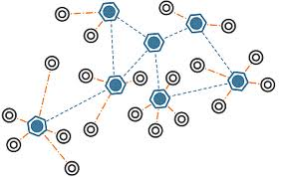
Introduction
Pervasive Healthcare
Traditional clinical setting → Home-centered setting
Wireless sensor networks & Web technologies
Internet
WSN
Notes:
Well, recent research approves that pervasive healthcare has the potential to reduce long-term healthcare expenses and improve quality of healthcare services, it also supports the desire for independent living and at-home care.
So what is pervasive healthcare?
The notion of pervasive healthcare presents us with a major shift from the traditional clinical setting to a home-centered setting. The development of wireless sensor networks and web technologies can improve communication among patients and healthcare givers. It enables the delivery of accurate medical information anytime anywhere.

Slide 5
Introduction
Related Work
CodeBlue – Wireless Sensors for Medical Care
PlaceLab – Living Labs to Study Context-aware computing
SAPHE – Smart and Aware Pervasive Healthcare Environment
Notes:
There are a number of research projects related to pervasive healthcare and context modeling.
For example, CodeBlue from Harvard Sensor Network Lab, they explor applications of wireless sensor network technology for medical care. PlaceLab from MIT, they build real living environments - "living labs" – which are used to study technology and design strategies in context. SAPHE from Philips Research Cambridge, they provide a pervasive health and social care solution that is optimized for the aging population and patients with long term conditions.
We are aware of the fact that research efforts are converging toward the combination of statistical reasoning
and ontology-based knowledge based representation, many approaches have been proposed focusing
on using semantic web languages with ontology and rules to build reasoning system. Our approach is similar to what we would obtain by using ontology, with difference that fuzzy-based reasoning is more expressive, flexible and efficient in computation, since we allow rules to be editable by user with natural language rather than fixed machine understandable rules also our reasoning engine works o-line on the client handling rules loaded from server and raw data collected from WSN in real-time.

Slide 6
System Overview
CARA for Pervasive Healthcare
CARA (Context-Aware Real-time Assistant)
Real-time
Intelligent
At-home healthcare
Rich Internet Application
Universal access
Real-time user interaction
Adobe Flash
Notes:
The CARA system is design to provide a real-time intelligent at-home pervasive healthcare solution.
The universal access makes the internet an ideal tool for remote monitoring applications. While in traditional web applications, there is a limit to the interactivity that can be added to a single page. To improve it, our approach is to develop the CARA system as a Rich Internet Application which allows the real-time user interaction. The system is implemented in Adobe Flash, the only tool required for running it is a web browser with the Flash plug-in installed which means the real-time remote monitoring is possible from any computer or suitable smart devices.

Slide 7
System Overview
CARA Components
Remote Monitoring System
WSN (Wireless Sensor Network)
Data Review System
Healthcare Reasoning System
Notes:
Basically, there are four main components in the CARA system:
1. Wireless Sensor Network.
As a key component of the system, WSN consist of BAN and environmental sensors. The body area network includes wearable wireless sensors such as the ECG, Oximeter, temperature, accelerometer and gyroscope sensors. Environmental sensors are virtually deployed in field to monitor the change of home environment.
2. Remote Monitoring System.
It is responsible for remotely controlling the wireless sensor network and continuously monitoring the vital signs of the patient and home environment. A web camera is integrated to this system for interaction between the patient and the caregiver.
3. Data Review System.
It is designed for the medical consultant to review the data previously collected from the patient in case they might be not available for real-time monitoring. It not only can present the recorded sensor data in graphic view but also allows the consultant to review the recorded video along with synchronized sensor data.
4. Healthcare Reasoning System.
It’s a fuzzy-based context modeling framework implemented in .Net. It applies medical rules to the real-time data received from WSN to keep tracking the current status of the patient and to predict the possible emergency. I’m gonna talk about it in detail later.

Slide 8
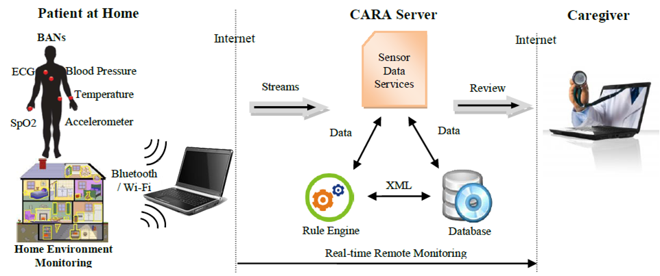
System Overview
System Architecture
Home Gateway
Notes:
This is the architecture of the CARA system. As you can see here. The patient’s vital signs are monitored by different kinds of sensors within the body area network and home environment is under monitoring as well. All measurement data are transmitted to home gateway through a wireless connection e.g. Bluetooth. In the meantime, the fuzzy-based rule engine load individual rules from the server and provide intelligent reasoning functions.
A problem with all wearable wireless sensors is the noise of signals, and this often results in data errors. Our solution is to integrate a Face-Time function into the system so that the caregiver can distinguish bad readings from significant readings.

Slide 9
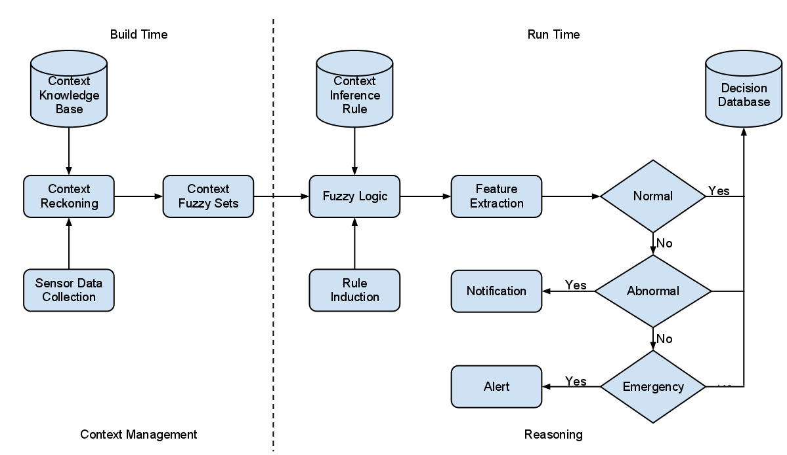
Reasoning Engine
Overview Flow Chart
Notes:
Now let’s have a look at the reasoning engine in CARA system.
Here is the overview flow chart of our fuzzy-based reasoning system. The reason why we choose fuzzy logic is because it provides a simple way to get a definite conclusion based on ambiguous, noisy, or missing input information. It is another approach to build reasoning system similarly like the ontology which is mostly used in knowledge based decision make systems.
So basically it collects sensor data and map them into fuzzy sets based on context knowledge. Then it applies fuzzy rules to the fuzzy input sets and generates fuzzy output sets. The final result is extracted from the output sets and stored in decision database.

Slide 10
Reasoning Engine
Context Modeling
- Person entity
Identify the person, his profile and his movement.
- Physiology entity
Identify vital signs of a person.
- Area entity
Identify rooms and area in the environment.
- Object entity
Identify objects the person can interact with.
Notes:
In context-aware systems context modeling is a key feature to provide context for intelligent services. We conclude the basic contexts required in a pervasive healthcare environment into four categories.

Slide 11
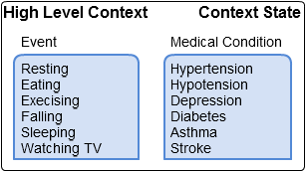
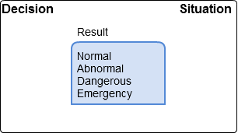
Reasoning Engine
Notes:
More specifically, we adopt a Fuzzy Logic Model to build low level and high level context models. Here we structure the low level context according to the Physiological Context, Personal Context and Environmental Context and generate high level context including Activity Event and Medical Condition. The final result is inferred from high level context which indicates the current status of a patient.

Slide 12
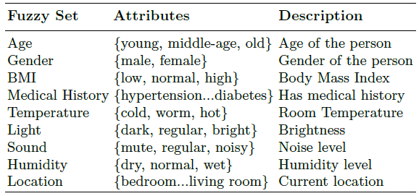
Reasoning Engine
Fuzzy Set Examples
Notes:
In our work, we map all the attributes of the context entities into Fuzzy Sets. The principle of building Fuzzy Sets is to design appropriate membership functions. A membership function represents the magnitude of participation of each input. It defines functional overlap between inputs, and ultimately determines the output response. This table here gives some examples of the fuzzy sets we design. Most of them are personal contexts and environmental contexts.

Slide 13
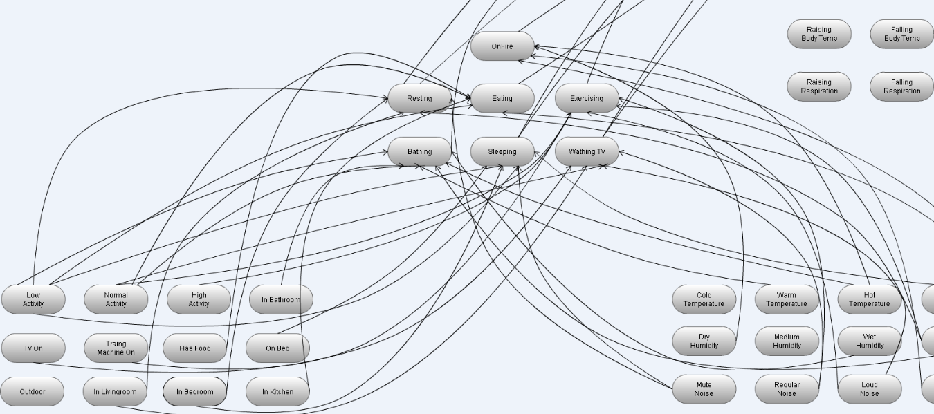
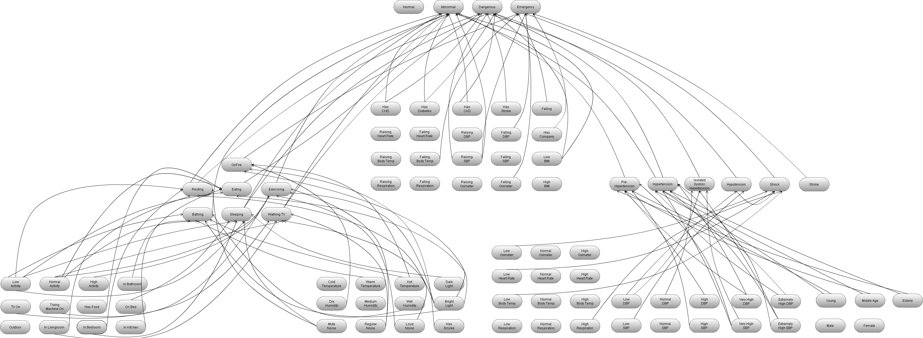
Reasoning Engine
Fuzzy Relations
Notes:
The relations among these fuzzy sets indicate the rules in our reasoning engine. The rules use the input membership values as weighting factors to determine their influence on the fuzzy output sets. The inputs are combined logically using the logical operator to produce output response values. Actually this graph only presents part of the fuzzy relations in our rule engine, I’m afraid it gonna be too messy to draw all the relations on the graph.

Slide 14
Reasoning Engine
Fuzzy Relations
Ambient Entities
Personal Entities
Medical History
Activity Events
Medical Condition
Decision
Object Entities
Physiology Entities
Notes:
So here I give you an abstract view of the fuzzy relations. First we have low level contexts, then we apply some rules to generate high level contexts. The overlaps among high level contexts indicate the rules which can be used to produce the final decision.

Slide 15
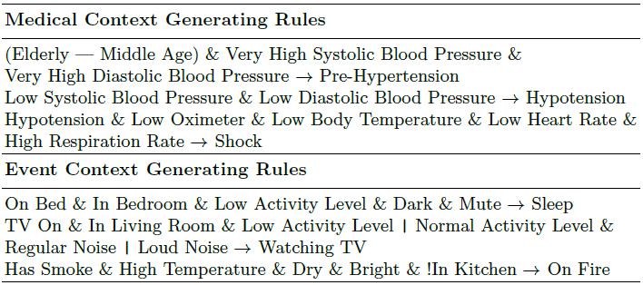
Reasoning Engine
Rules Example
Notes:
This is an example of generating high-level context rules. Such rules can be specified by medical experts or a particular healthcare giver in natural language. They can also be modified individually.

Slide 16
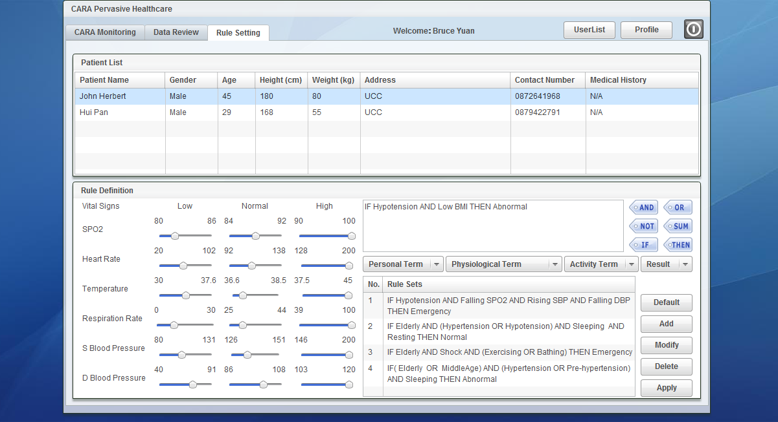
Reasoning Engine
Rules Setting
Notes:
This is the user interface of fuzzy sets and rules design. The left part is used for fuzzy membership function design and right part is rule definitions.
All the settings and definitions are personalized for each patient and they are stored in server database.

Slide 17
Case Study
1
2
3
Real-time Remote Monitoring Under Supervision
Real-time Remote At-home Monitoring
Remote Pervasive Healthcare & Data Review
Notes:
The CARA system can be used in different ways, varying from fully automatic real-time monitoring of patient vital signs, to use as a non-automatic assistant for remote consultation by a medical consultant. Now we will go through three case studies of using the CARA system.

Slide 18
Case Study
Real-time Remote Monitoring Under Supervision Scenario
Web
Notes:
This our first scenario where the wireless sensors are initially introduced to the patient under supervision in a clinic, and the real-time monitoring is provided by a remote medical consultant. This use of the CARA system provides a very acceptable starting point for both patient and caregiver.

Slide 19
Case Study
Real-time Remote At-home Monitoring
Scenario
Web
Notes:
The second scenario, involves real-time remote at-home monitoring without supervision. Again there are real-time data and video streams for the remote medical consultant. Both scenarios involve two-way video links so the patient also has a direct view of the remote caregiver. This is also a very important part of gaining acceptance for the technology.

Slide 20
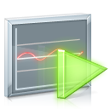
Case Study
Remote Pervasive Healthcare & Data Review Scenario
Sensor Data Review
Web
Video Replay
Notes:
The last scenario which is also our final goal. It supports independent living and at home healthcare. Once the patients get used to our system, they can use the intelligent services at home by themselves without supervision or remote consultation. All the important sensor data and patient’s status are recorded on the server for the medical consultant to review later. The Data Review function supporting this scenario includes the sensor data review and video replay applications.

Slide 21
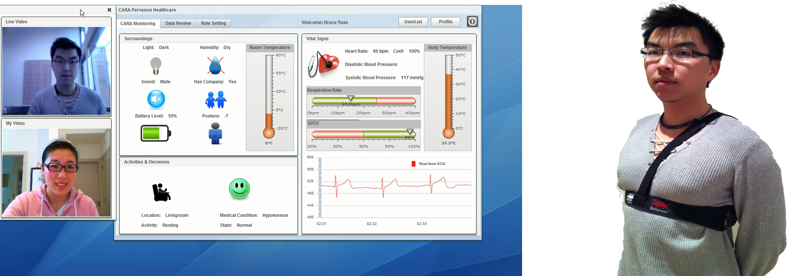
System Evaluation
Snapshot
Notes:
It is difficult to evaluate the CARA system entirely without realistic field deployment. However, we carry out simulation experiments in our lab to test the correctness of the proposed fuzzy-based reasoning framework in a pervasive healthcare environment. For this test stage, real-time vital signs of the patient are collected from wearable BioHarness sensors as shown on right which provide ECG, body temperature, heart rate, respiration rate and accelerometer readings. While environmental sensing is simulated by an android agent application so we can remotely control the change of home environment. The left is screen shot of our remote monitoring application with video communication, information gathered from sensors and decision made by the rule engine.

Slide 22
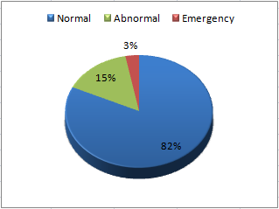
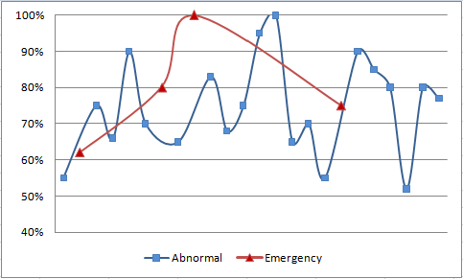
System Evaluation
Use Case Testing
(a) Scale of situation prediction (b) confidence of situation prediction
Notes:
The pie chart shows the scale of different status summarized from the trail tests. Most of the case are Normal while over 10% situations are Abnormal and round 3% are considered as Emergency. The graph on the right shows the confidence of Abnormal and Emergency situation. The confidence value is generated from the crisp value of fuzzy output set. The result shows 20 Abnormal cases and 3 Emergency cases overall. The confidence value is changing from 60% to 100%.

Slide 23
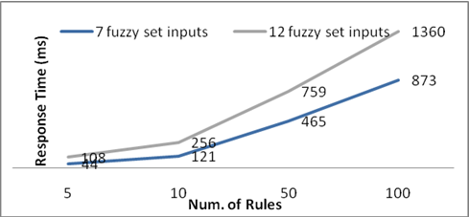
System Evaluation
Performance
Different amounts of fuzzy rules with several data sets input are applied
Notes:
To measure the performance of our approach, we added a time check function in the code. We checked a start time before calling the method, and then checked a finish time after calling the method. So we can get the execution time of the reasoning task. We applied different amounts of fuzzy rules and tested them with several data sets input. Obviously the response time of our rule engine increases linearly with the increasing of the amount of fuzzy sets and rules.

Slide 24
Demo Video
Notes:
To finish my presentation, I will give you a vivid view of the CARA system. Here is the demo video of the application.
First we login in as a medical consultant. Then we can select an online patient for a small chart. We can also request for a remote monitoring. Once the request is accepted by the patient. We will get a live video link with real-time remote sensor data from the patient. This is how the remote monitoring function works.
Now we close this monitoring session. For further use, the medical consultant can review the last session by selecting a patient and choose a recorded session.
This is the view of video replay function with recorded video and synchronized sensor data. We can pause or continue the video replay.
There is another use of the review function, we can review the sensor data in any custom time period by setting these timestamps. The recorded sensor data will be shown in a flash chart.
Here we go. The chart supports zooming and scrolling function, we can even define the time period in the chart. The chart presents different kinds of sensor data in different views. Here is the ECG data, there is also a playback function in the chart, it allows user to play the data in any speed.

Slide 25
Demo Video
Notes:
To finish my presentation, I will give you a vivid view of the CARA system. Here is the demo video of the application.
First we login in as a medical consultant. Then we can select an online patient for a small chart. We can also request for a remote monitoring. Once the request is accepted by the patient. We will get a live video link with real-time remote sensor data from the patient. This is how the remote monitoring function works.
Now we close this monitoring session. For further use, the medical consultant can review the last session by selecting a patient and choose a recorded session.
This is the view of video replay function with recorded video and synchronized sensor data. We can pause or continue the video replay.
There is another use of the review function, we can review the sensor data in any custom time period by setting these timestamps. The recorded sensor data will be shown in a flash chart.
Here we go. The chart supports zooming and scrolling function, we can even define the time period in the chart. The chart presents different kinds of sensor data in different views. Here is the ECG data, there is also a playback function in the chart, it allows user to play the data in any speed.

Slide 26
Thank You !
University College Cork

